Slide 1

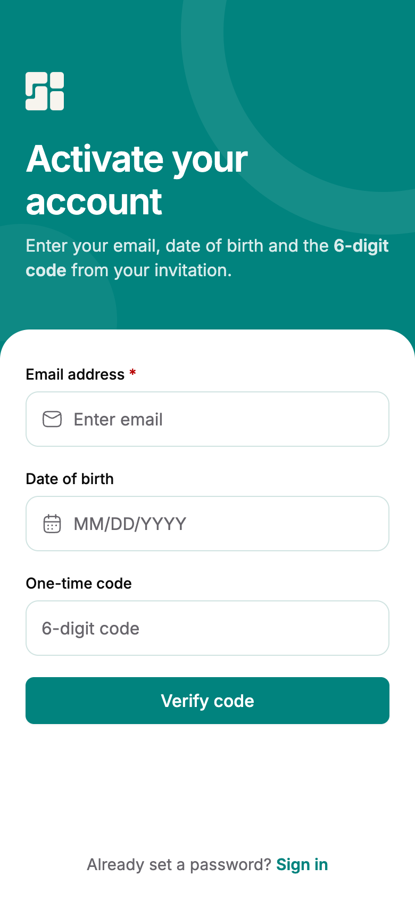
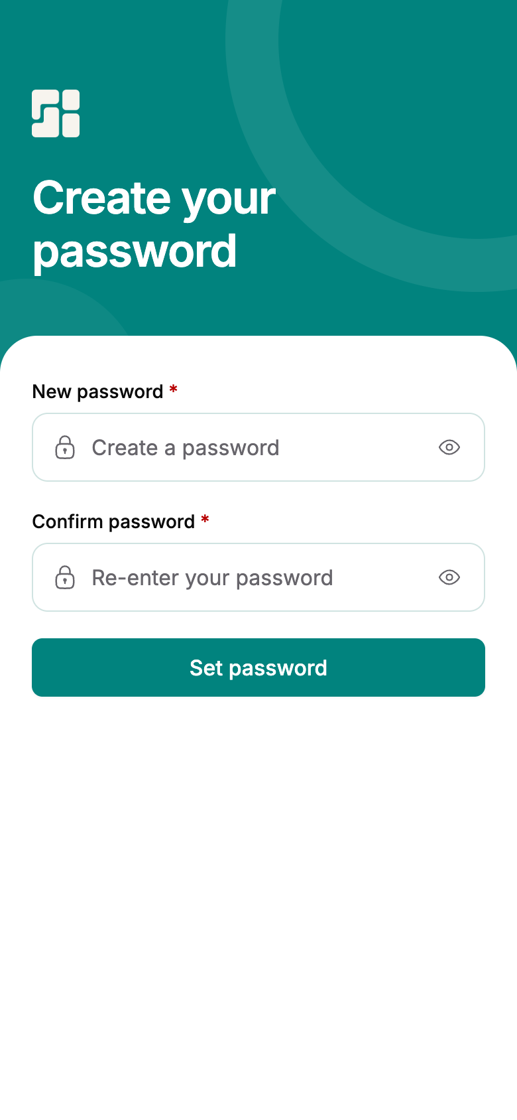
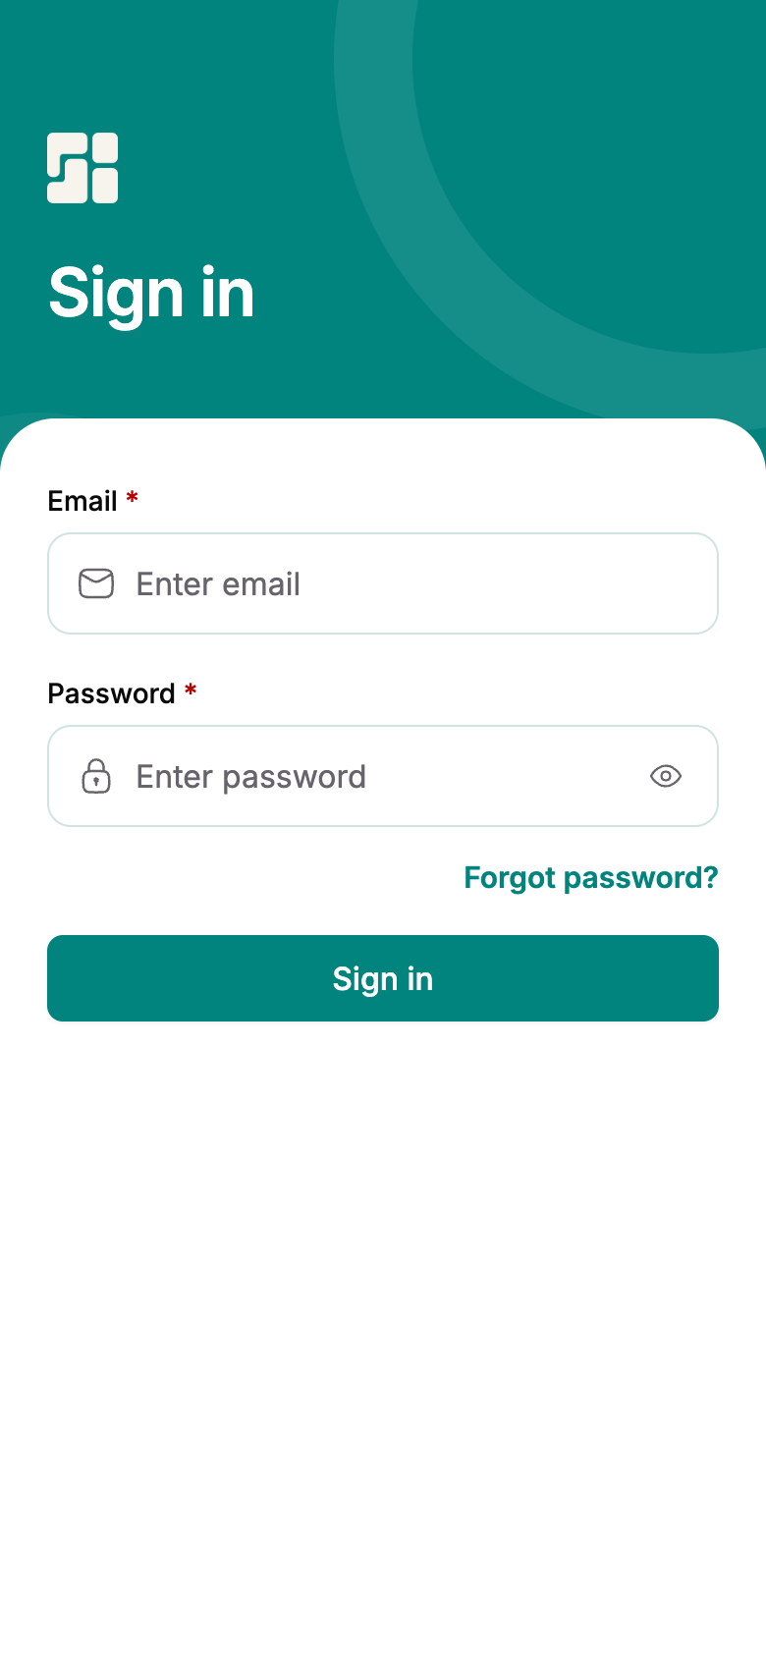
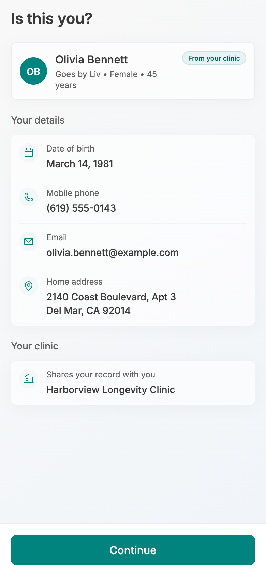
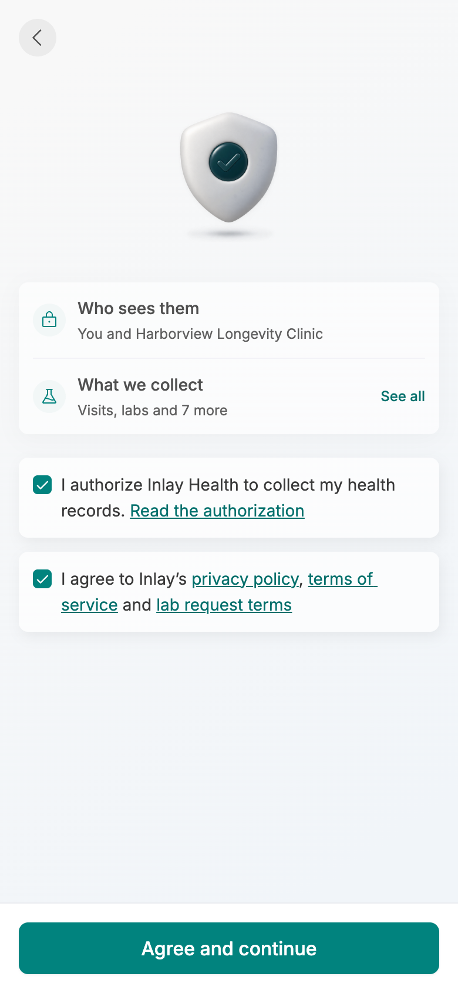
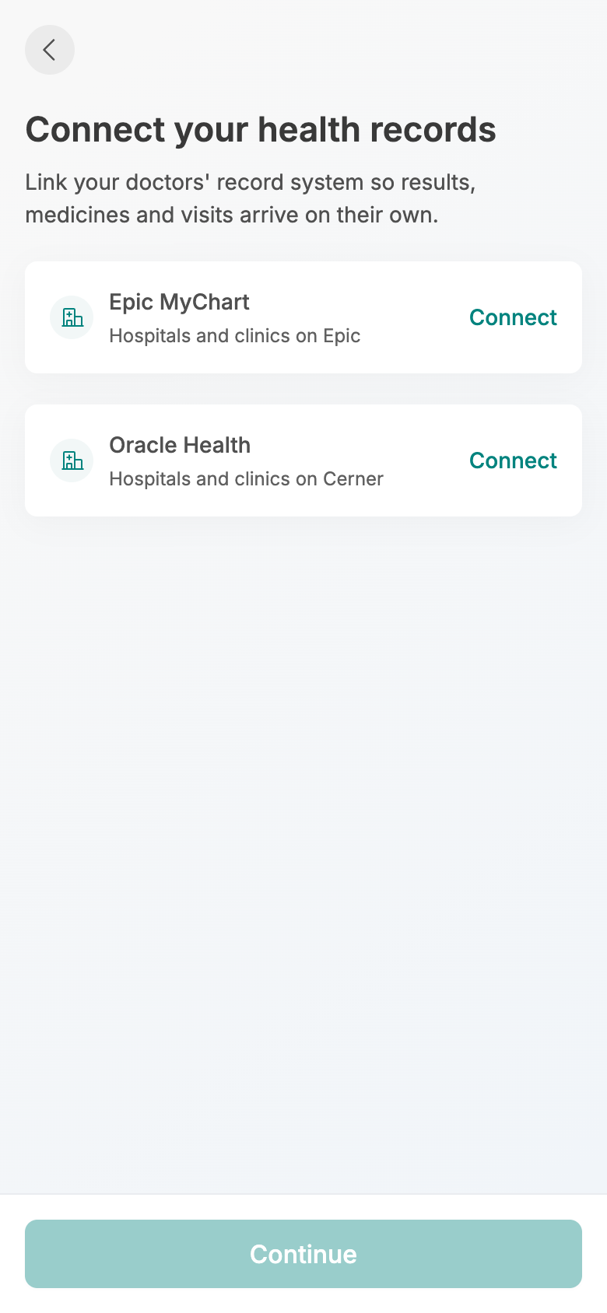
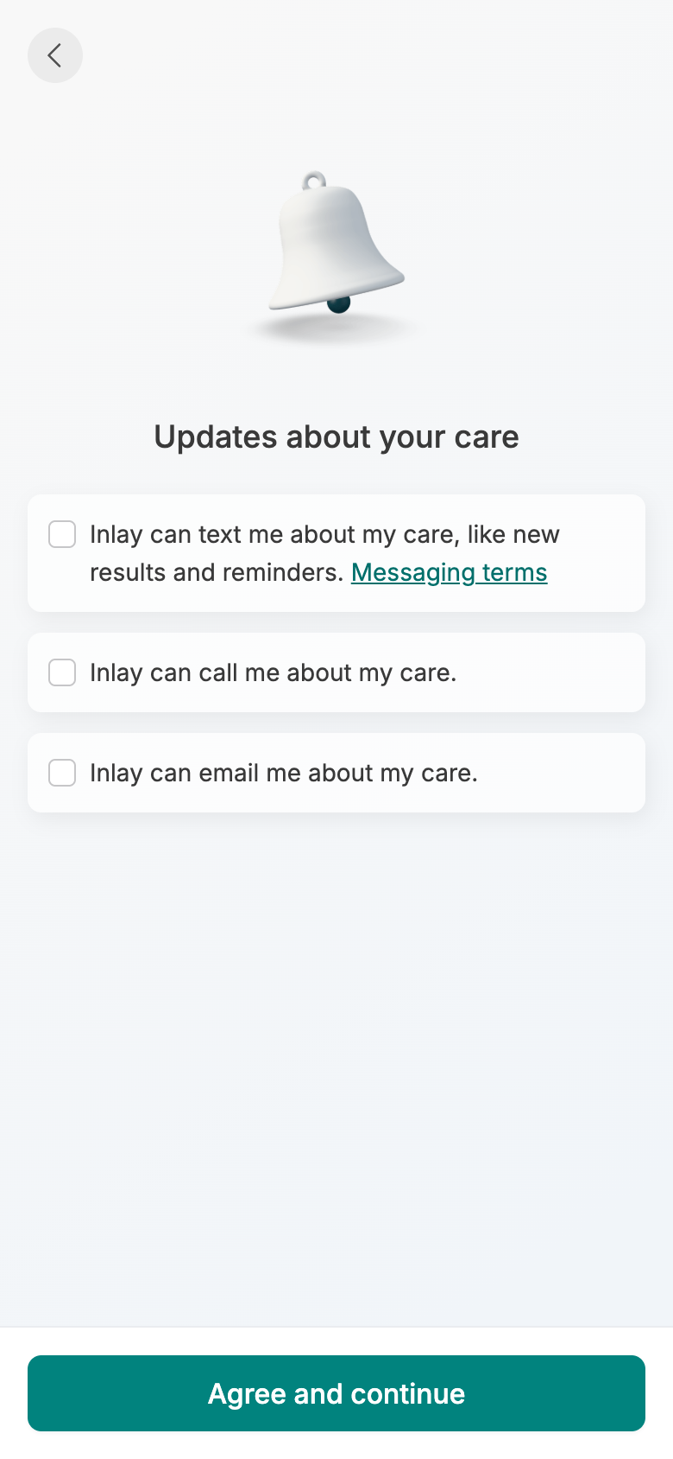
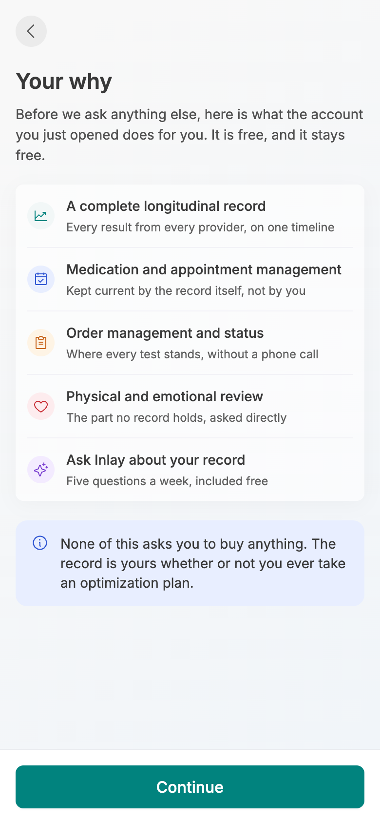
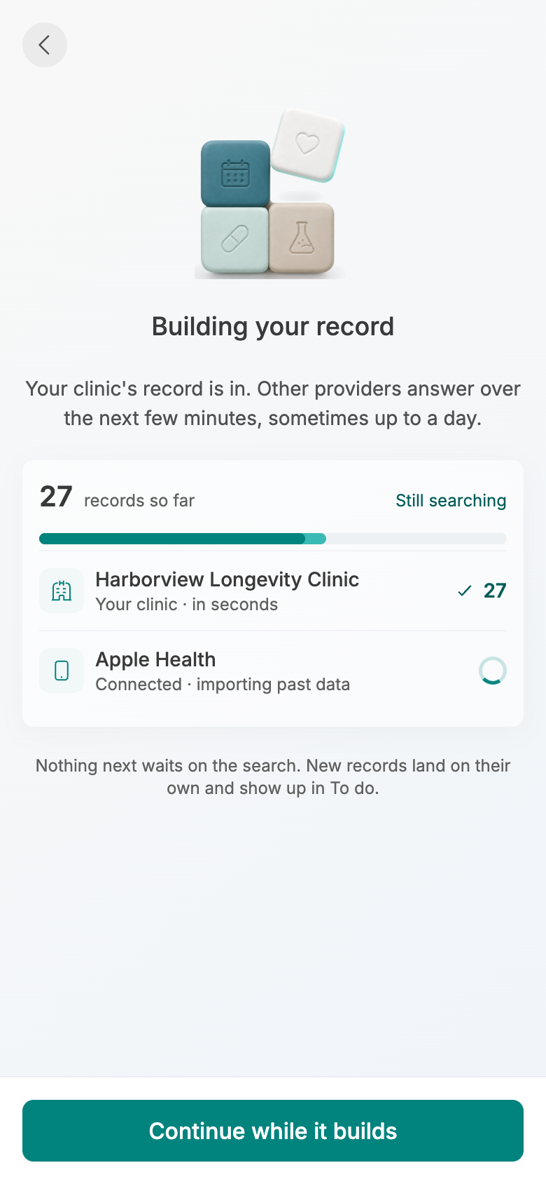
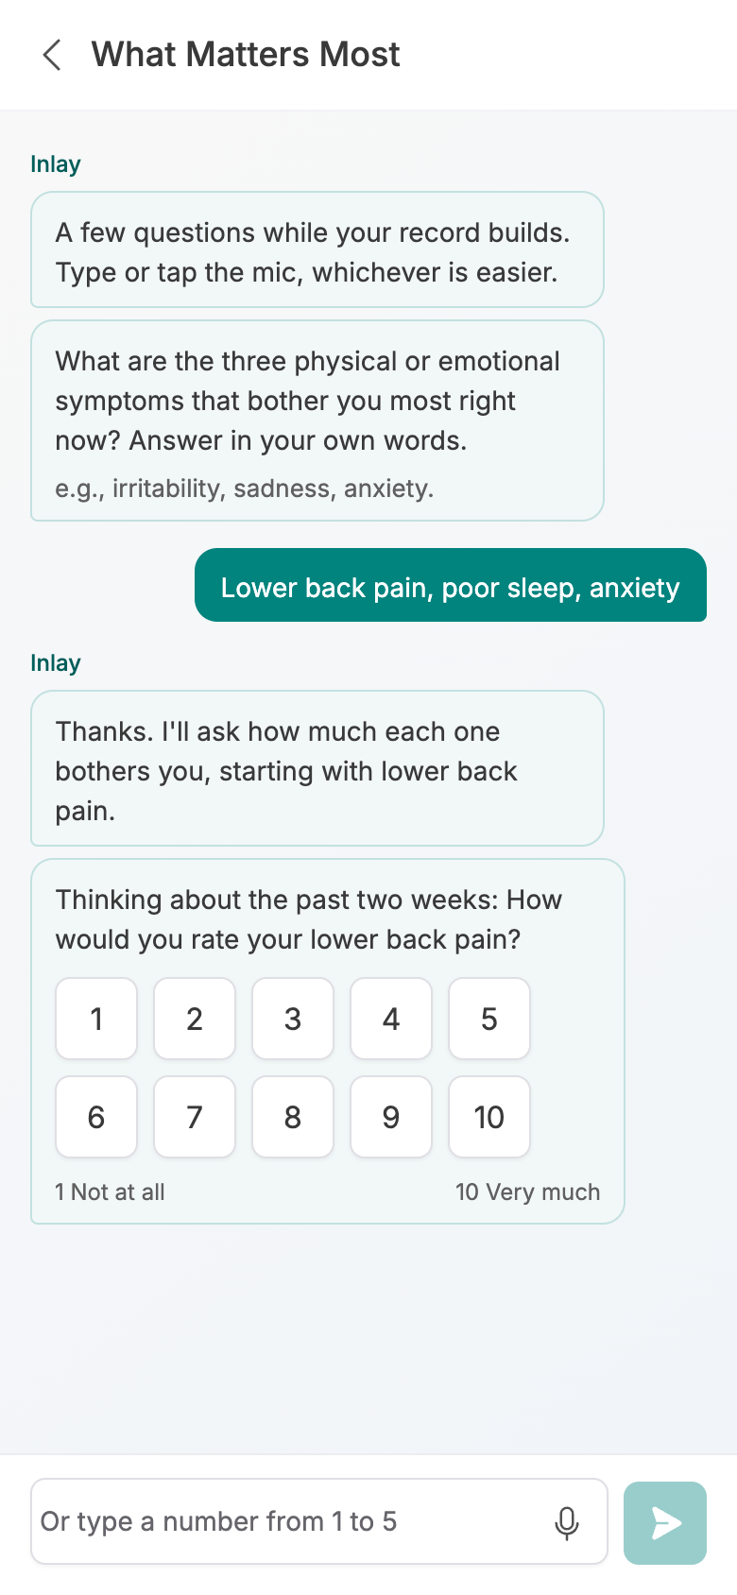
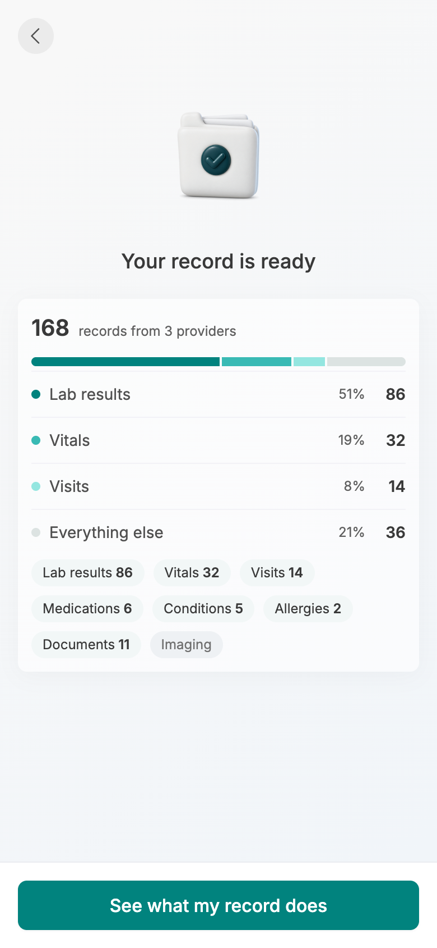
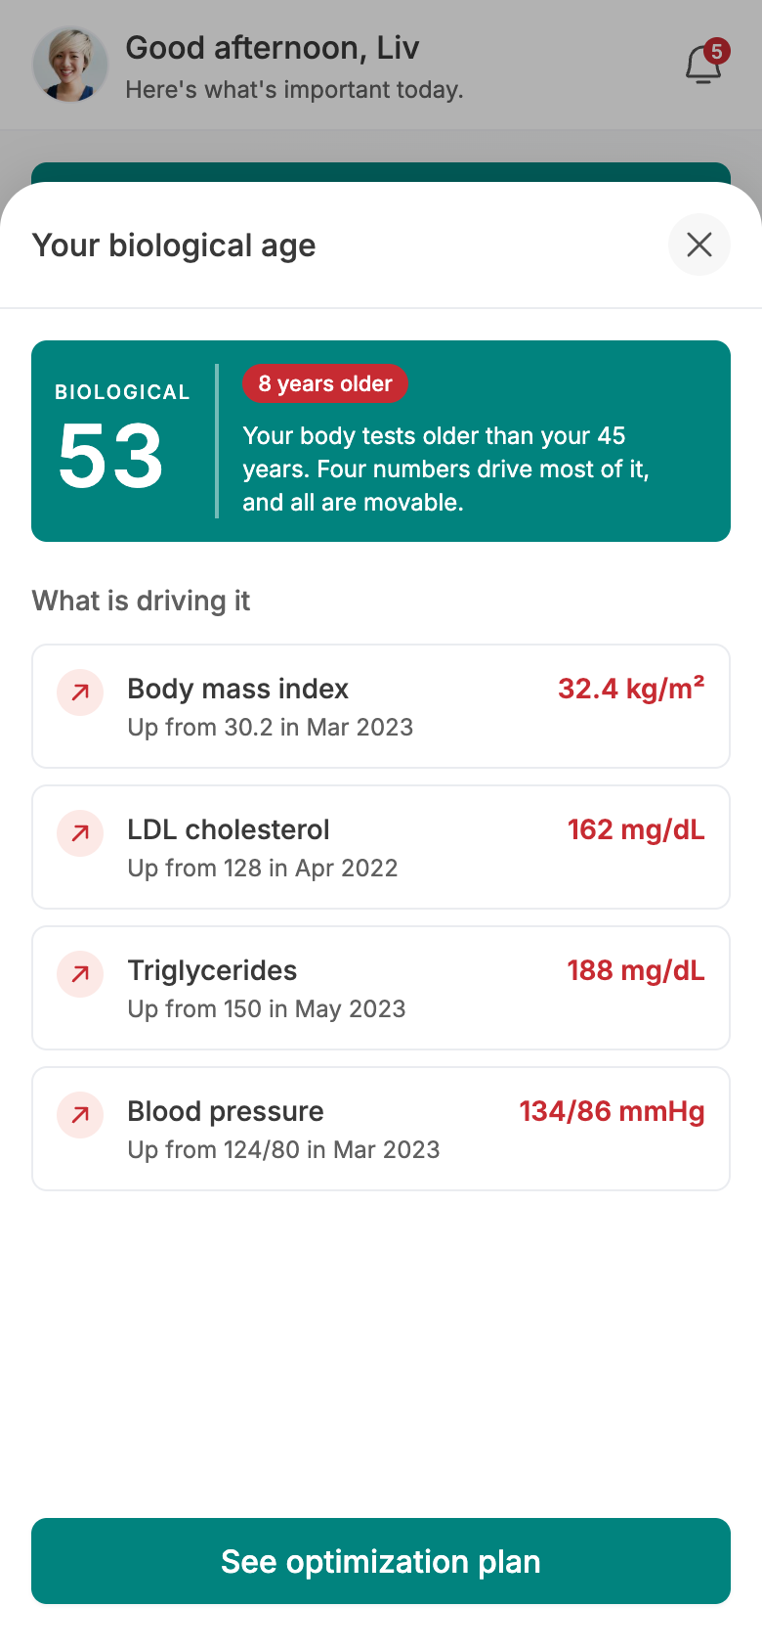
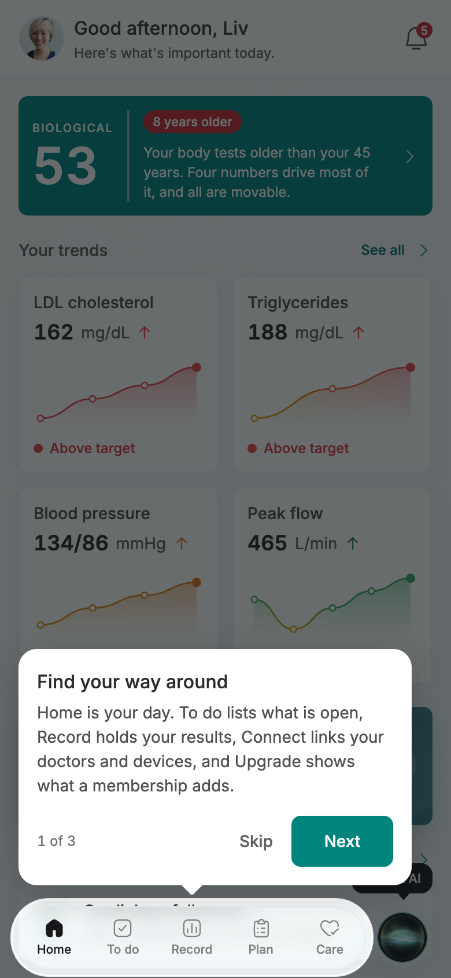
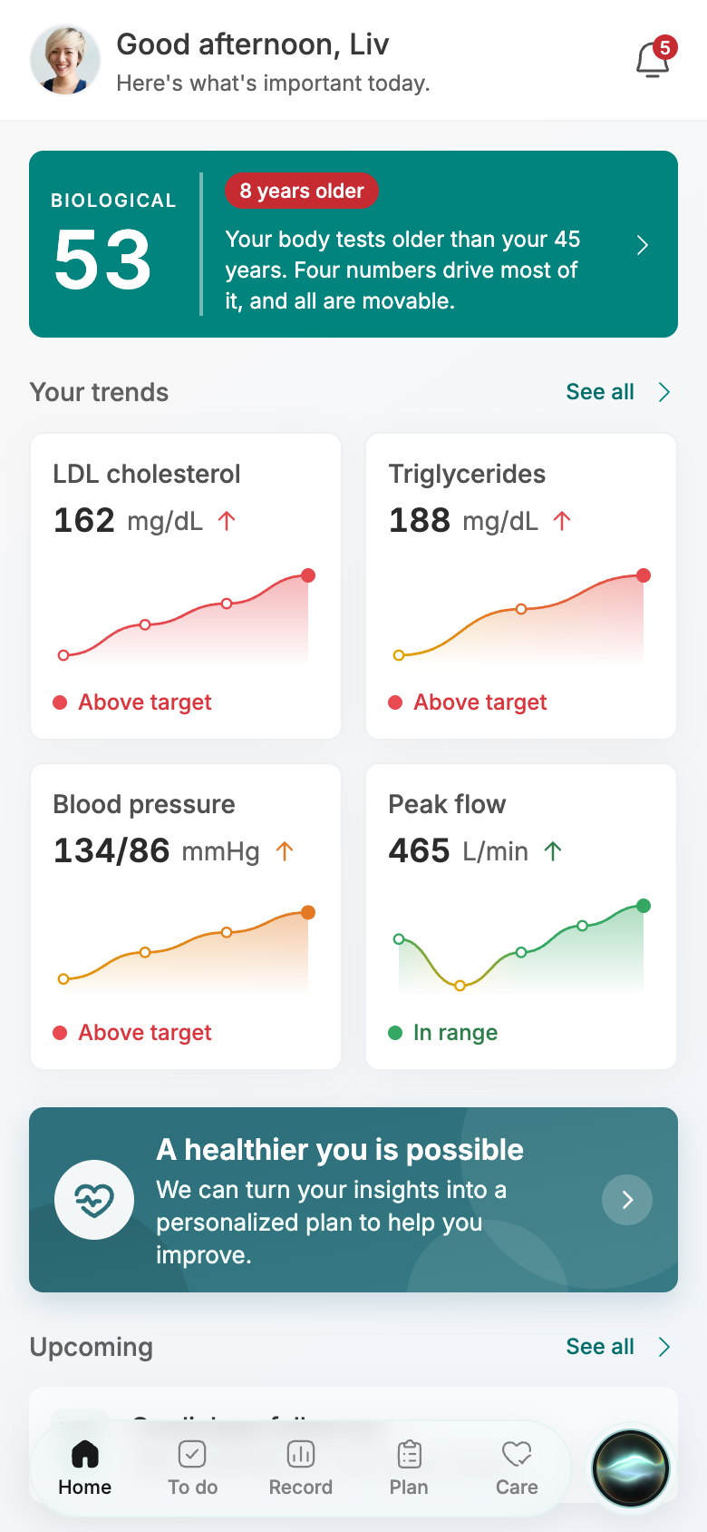
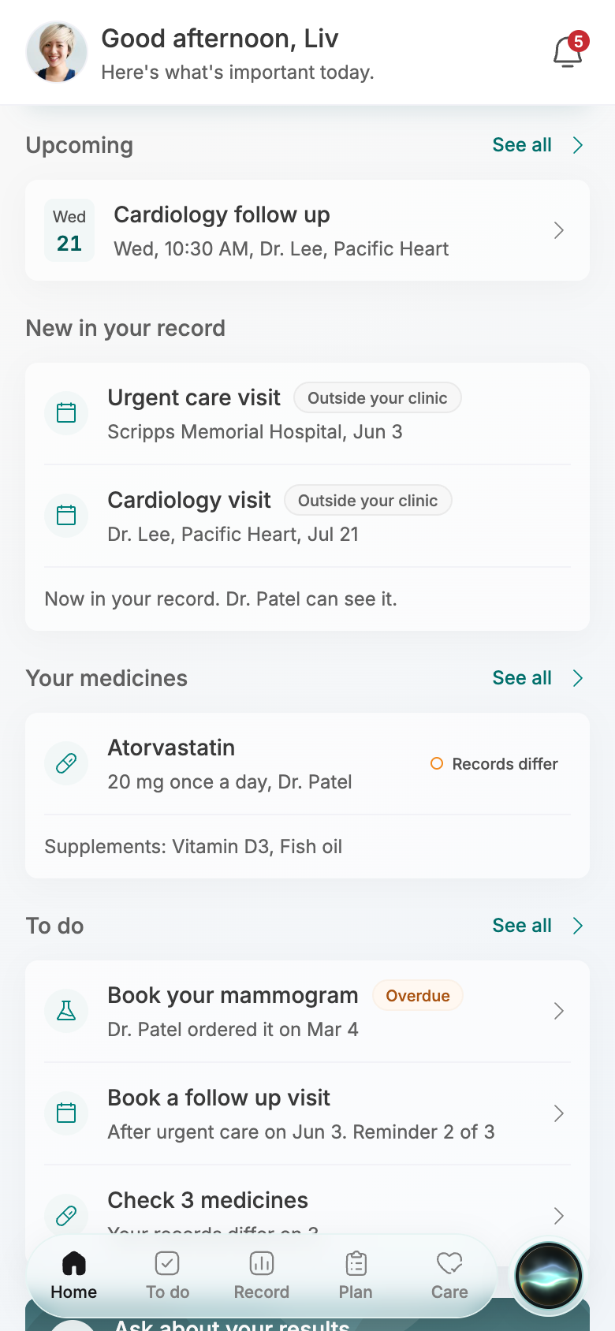
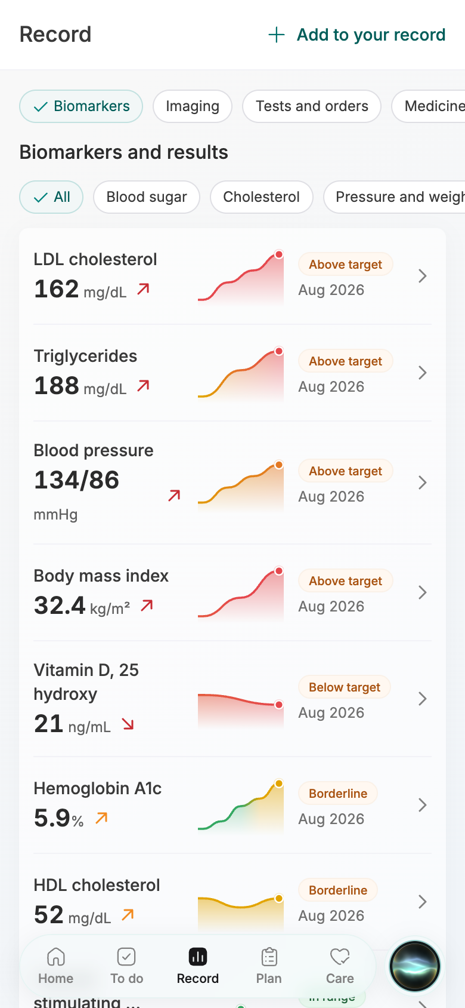
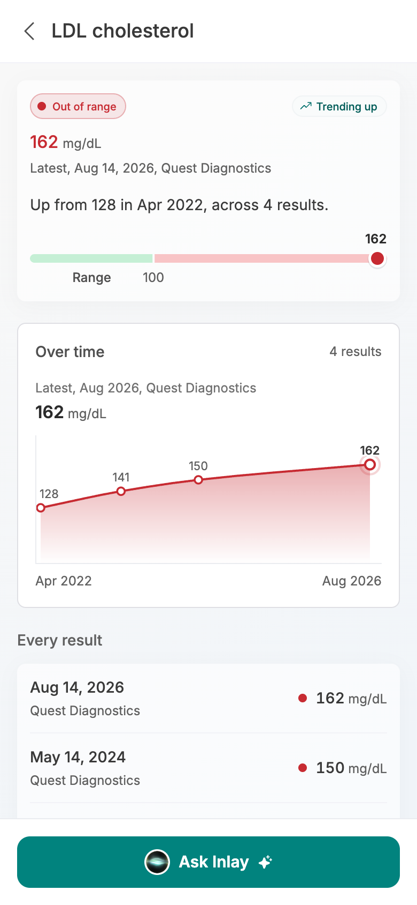
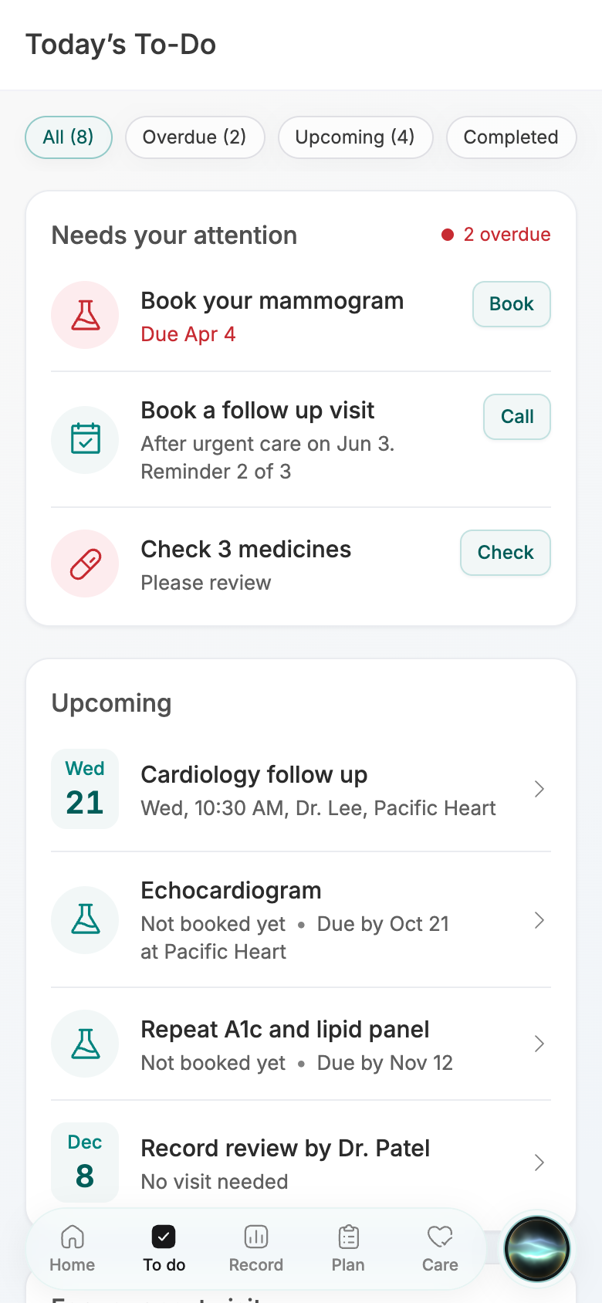
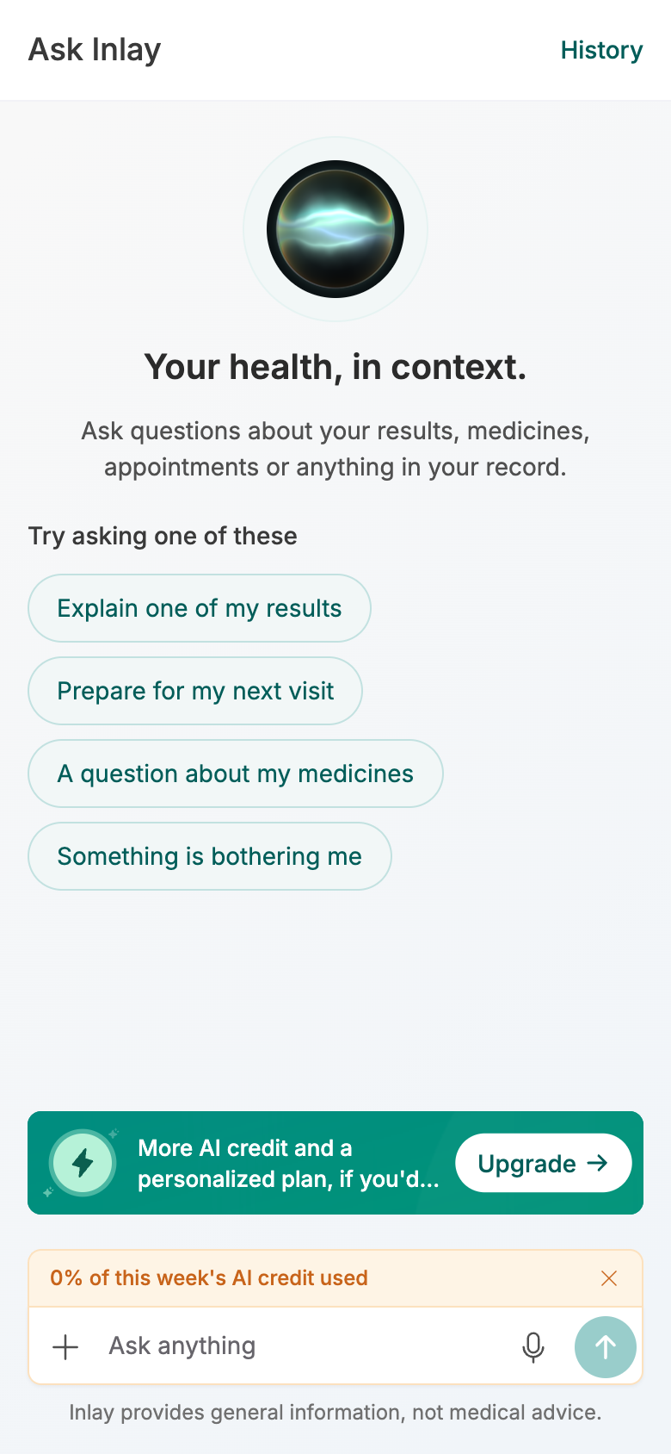
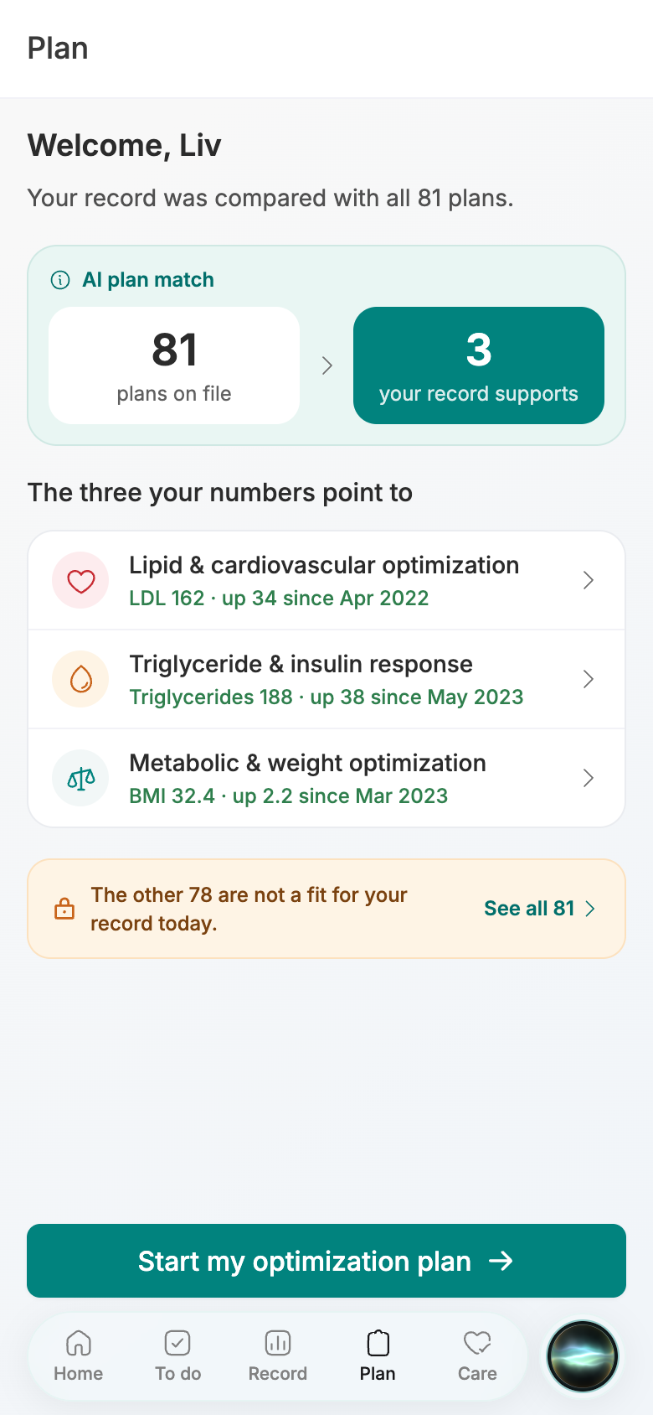
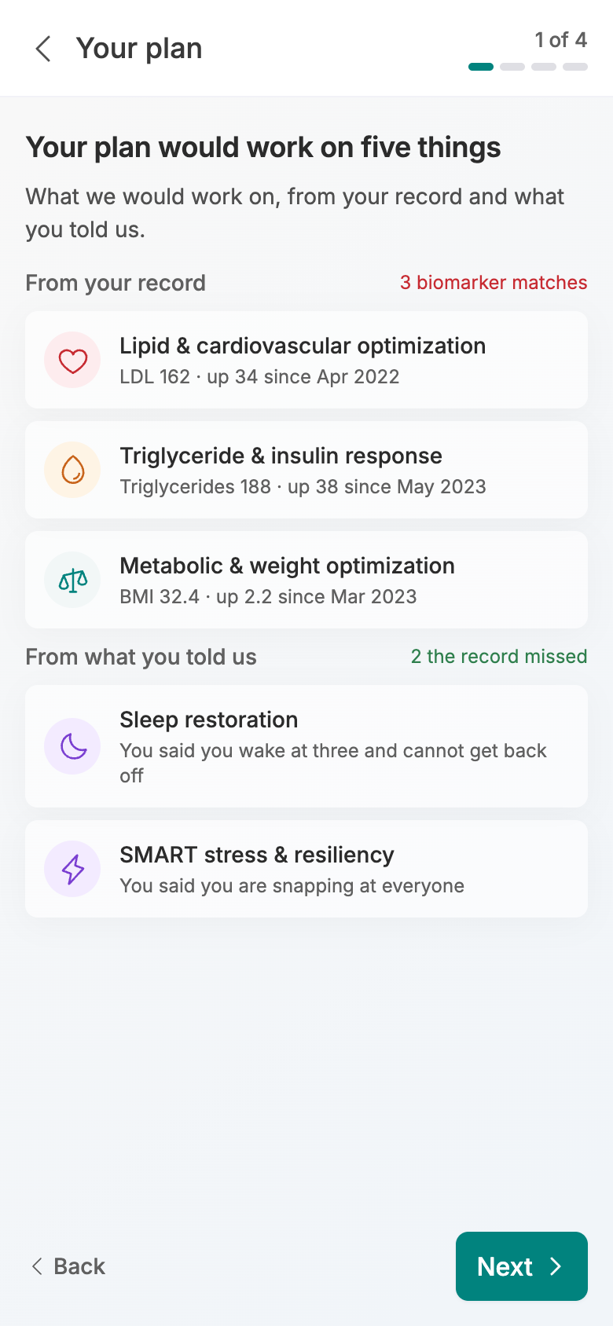
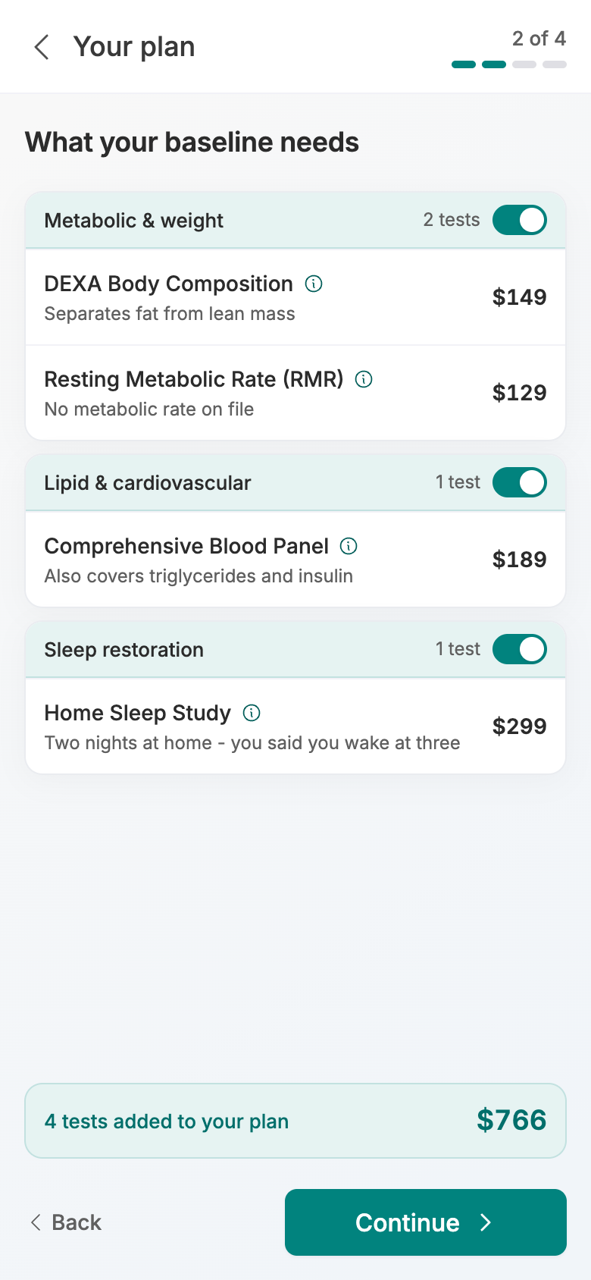
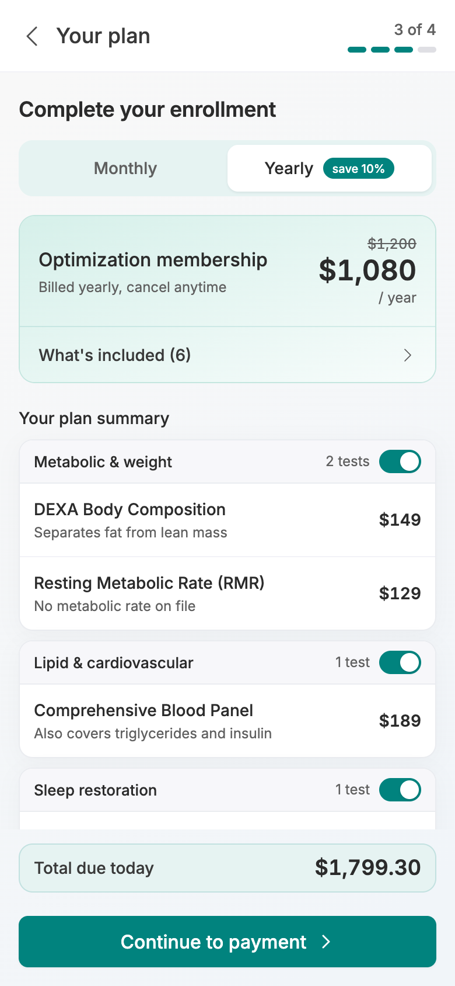
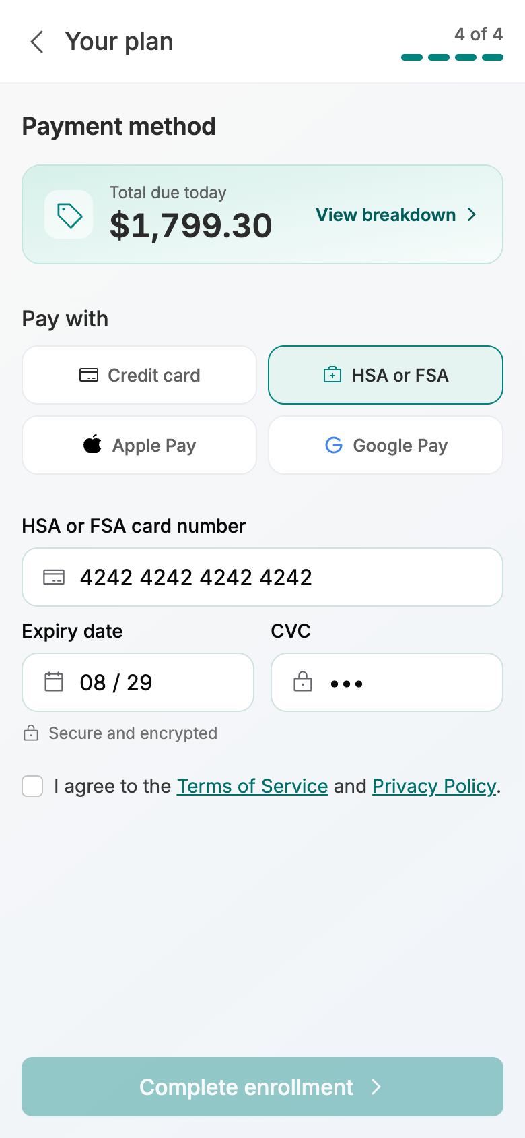
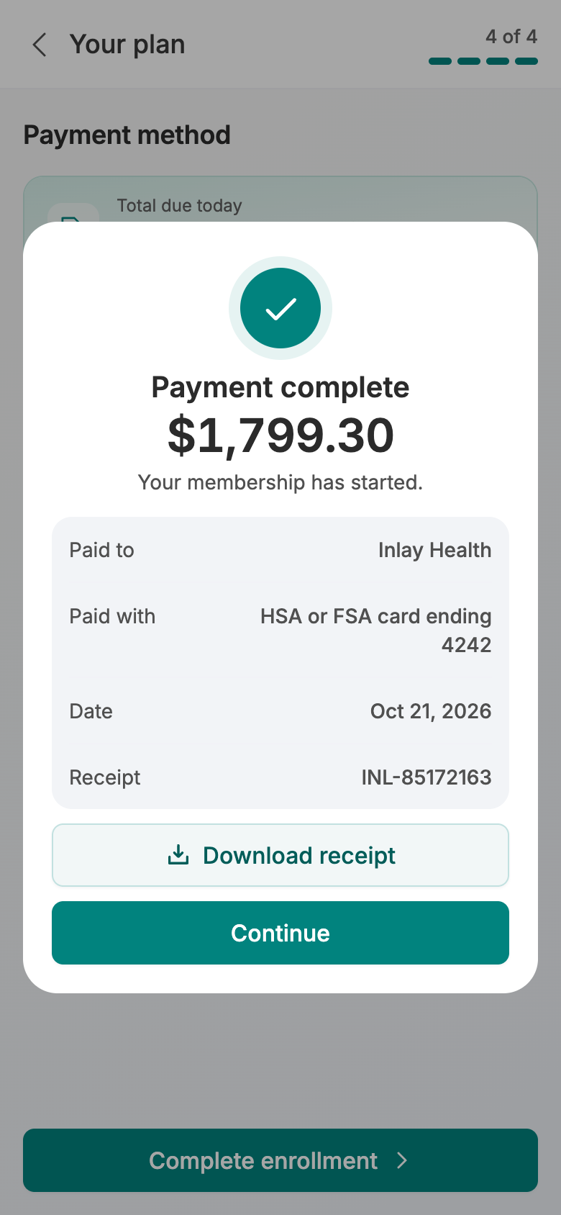
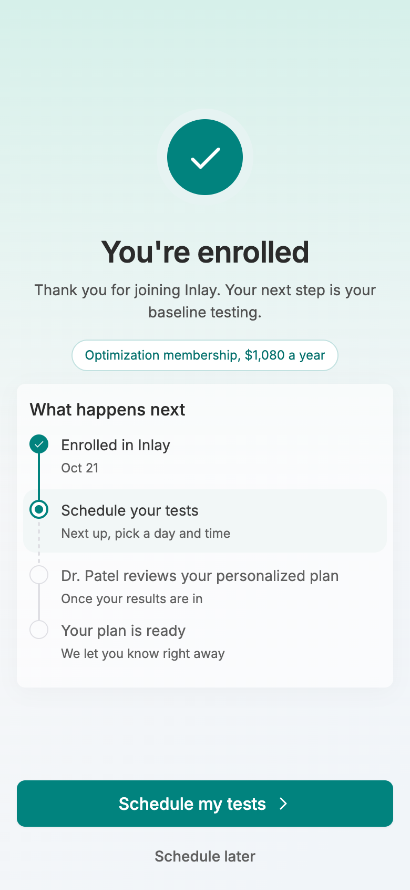
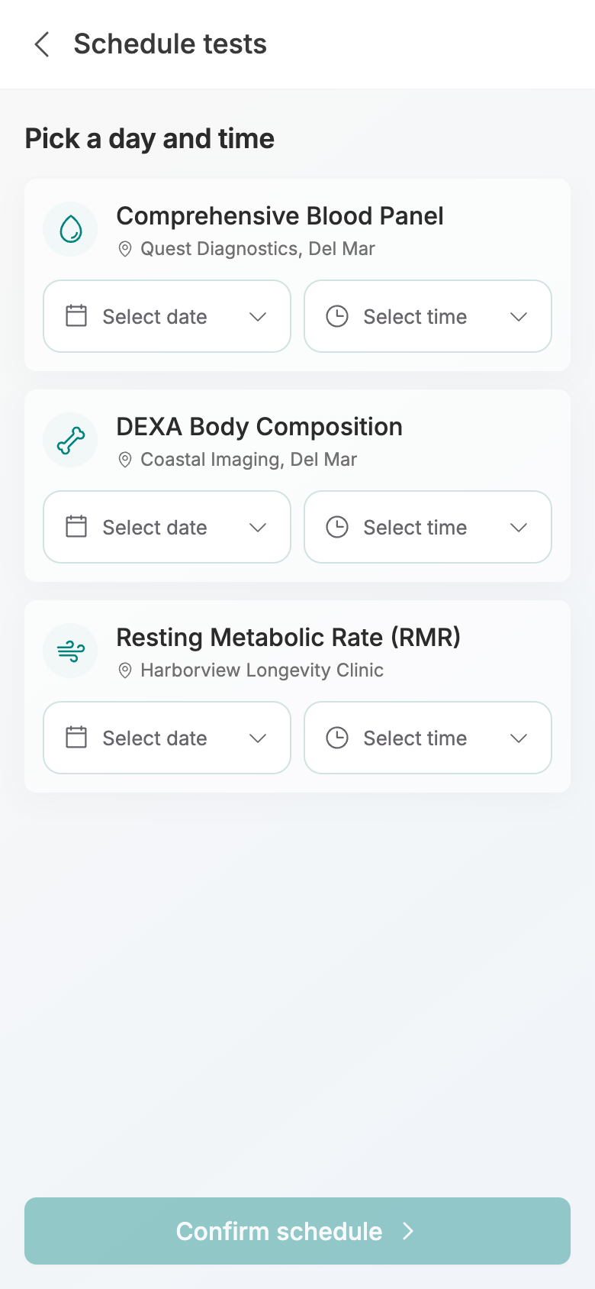
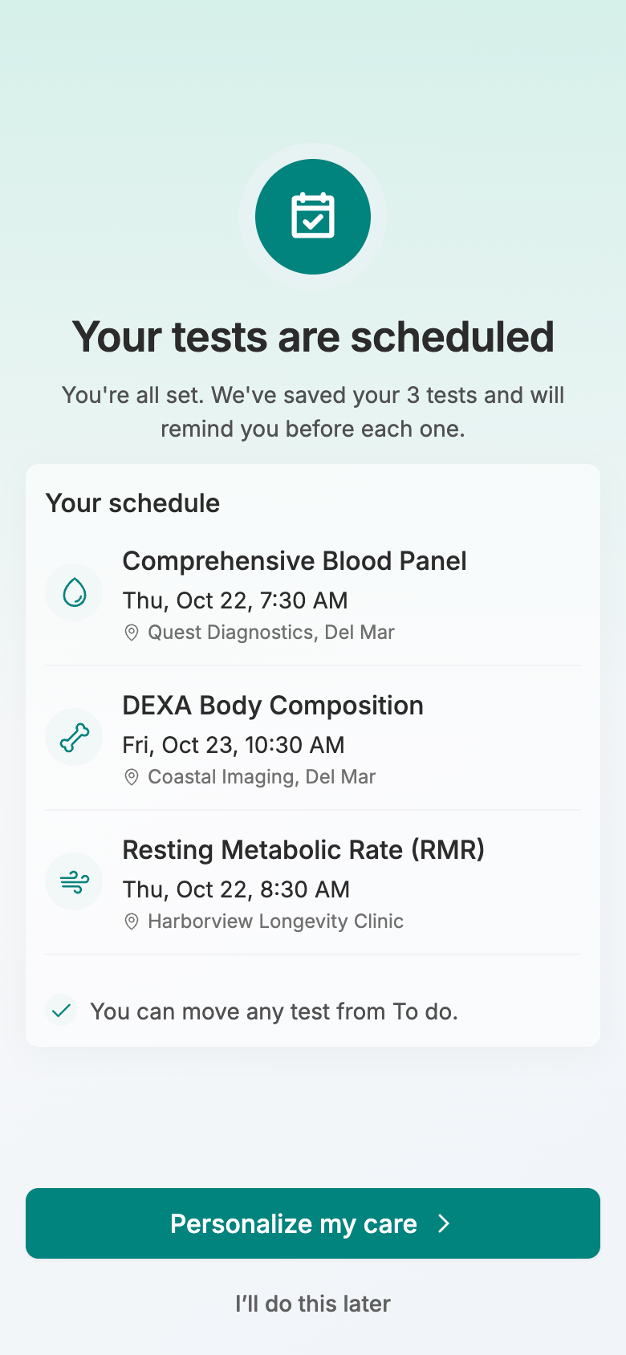
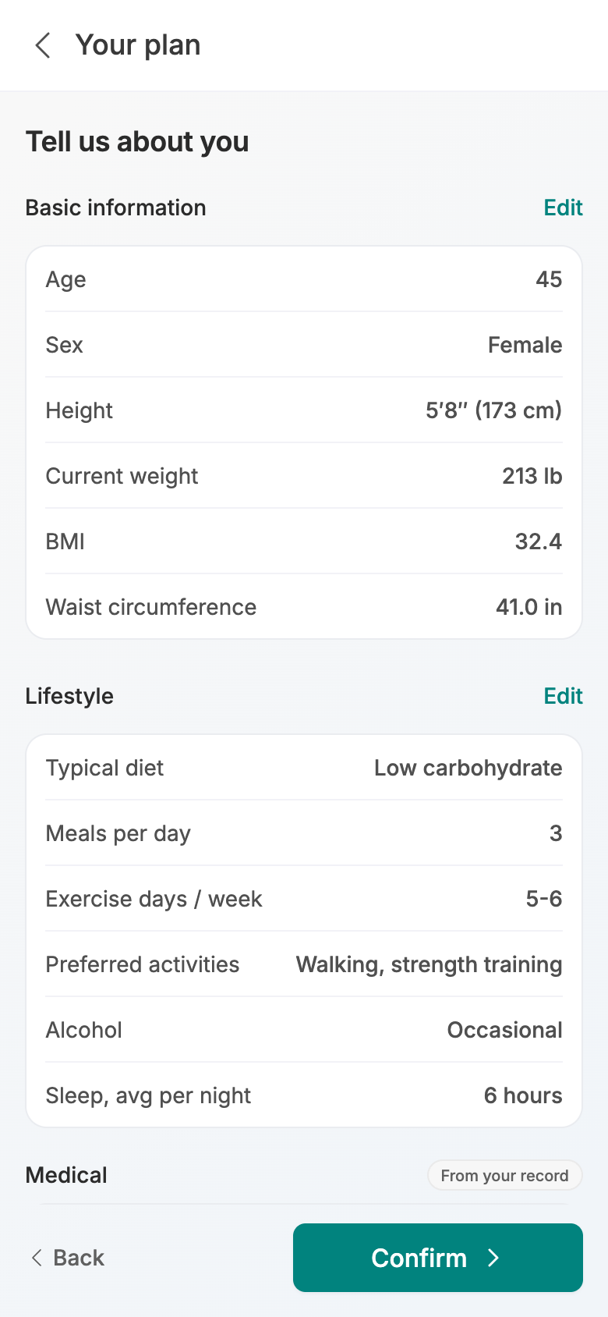
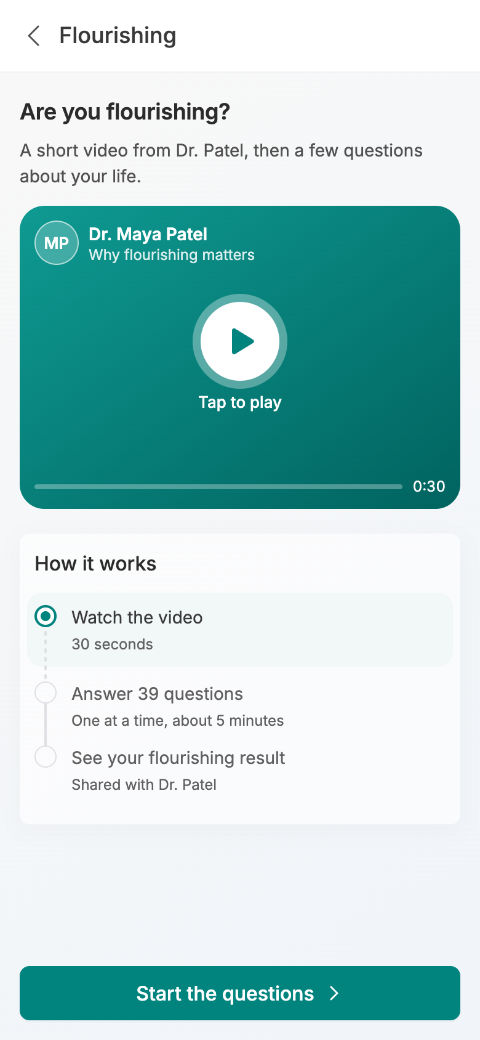
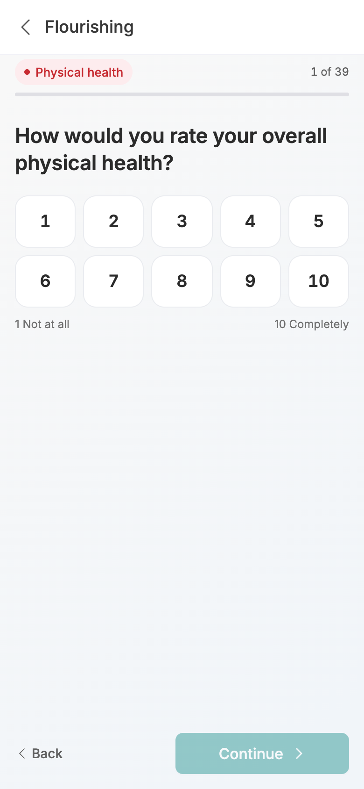
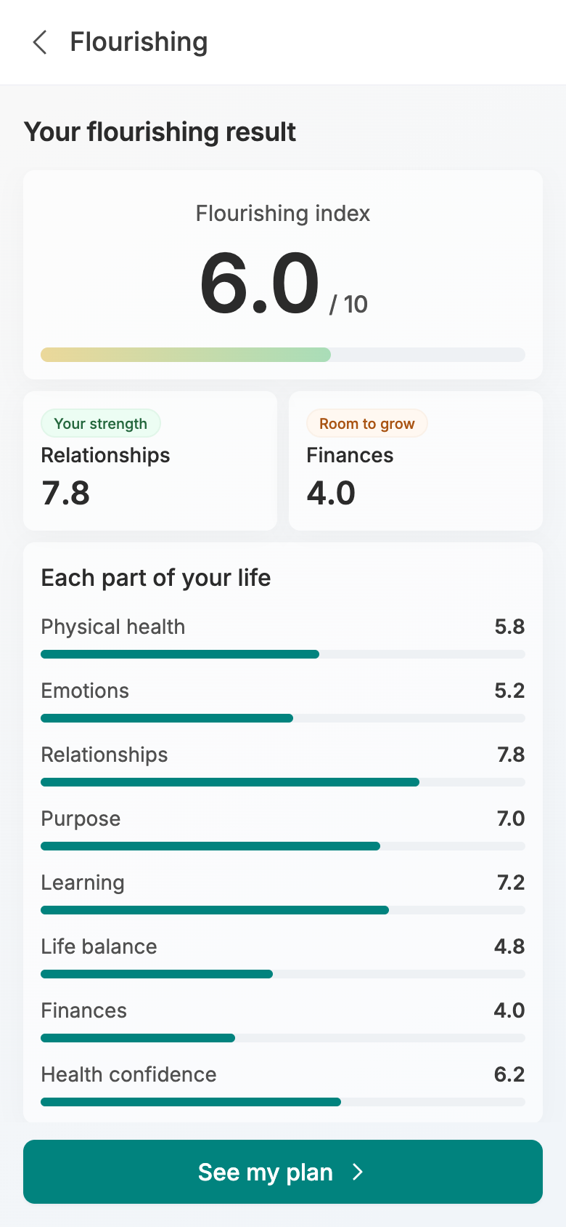
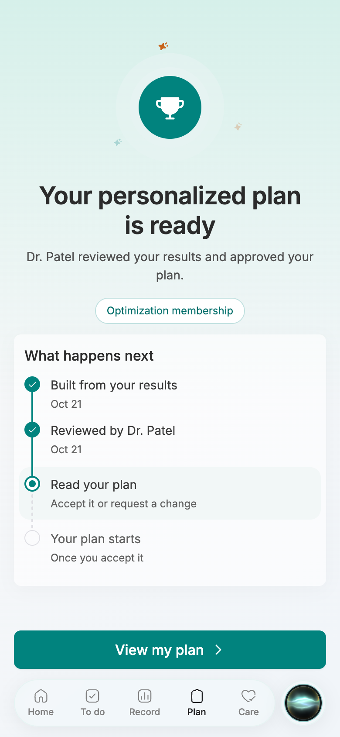
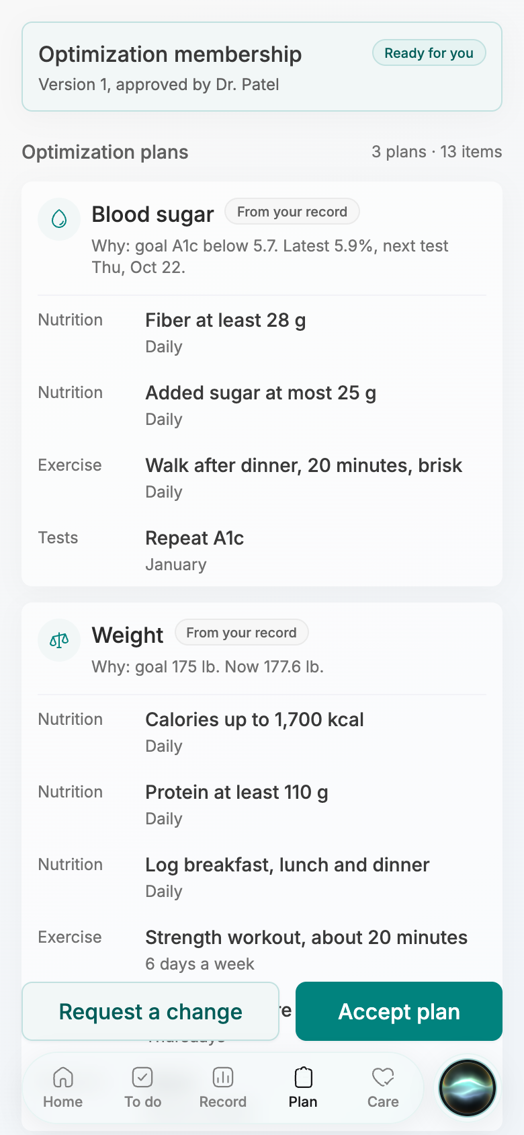
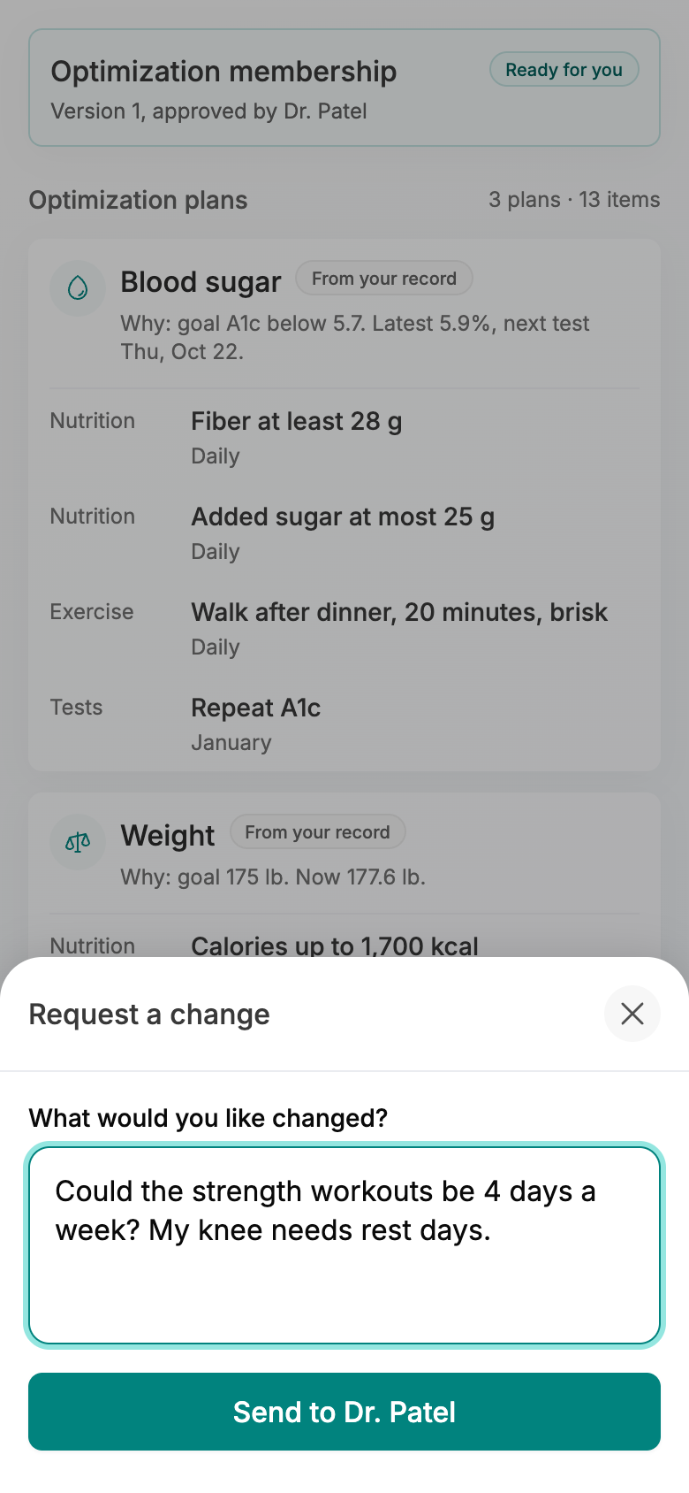
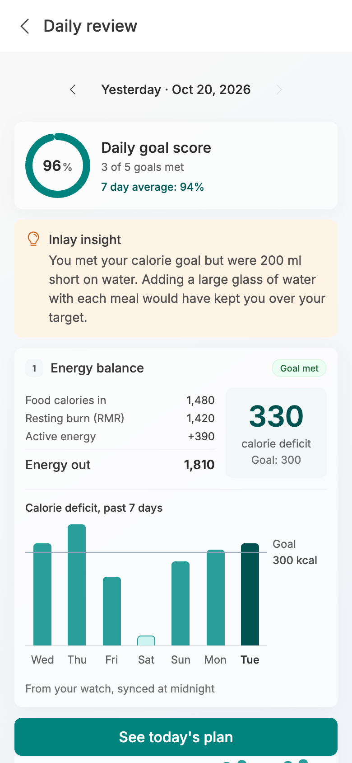
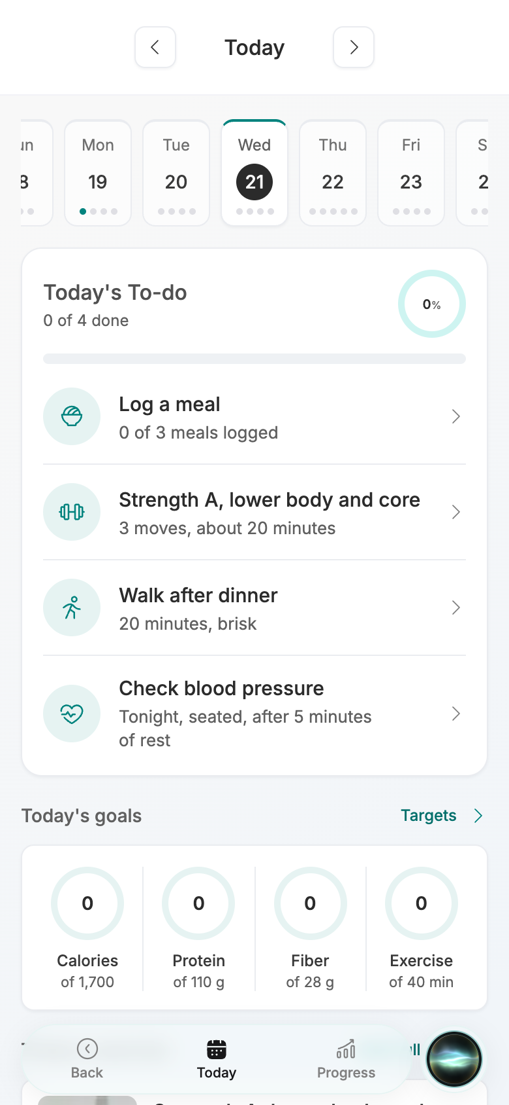
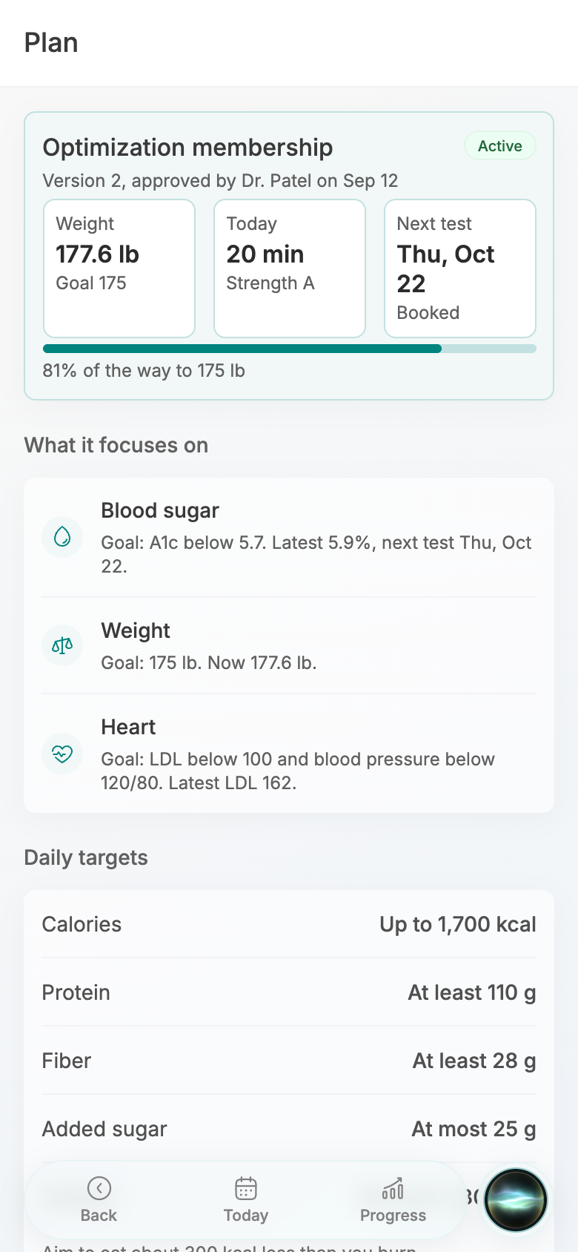
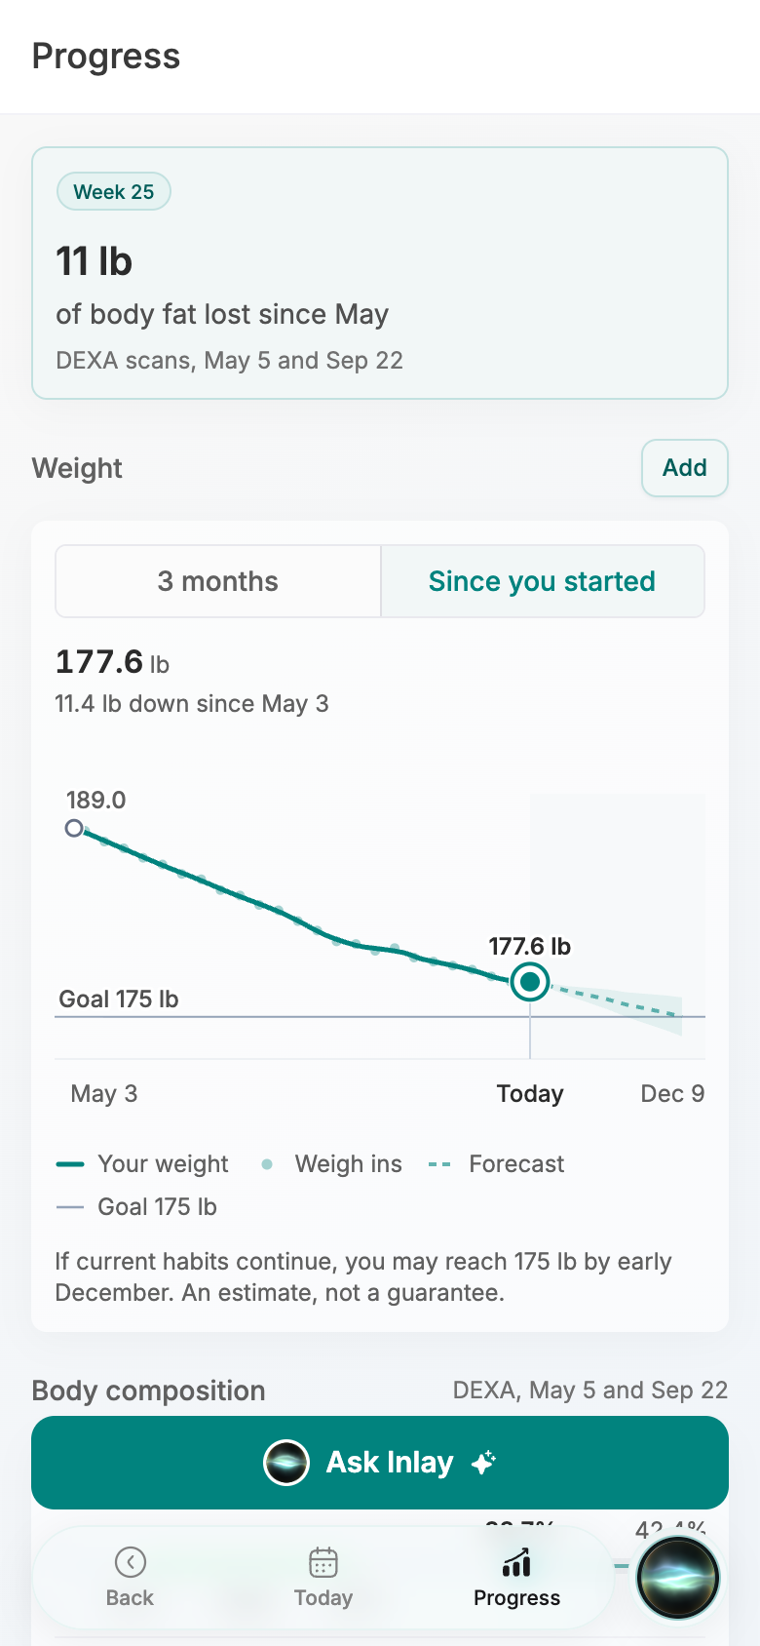
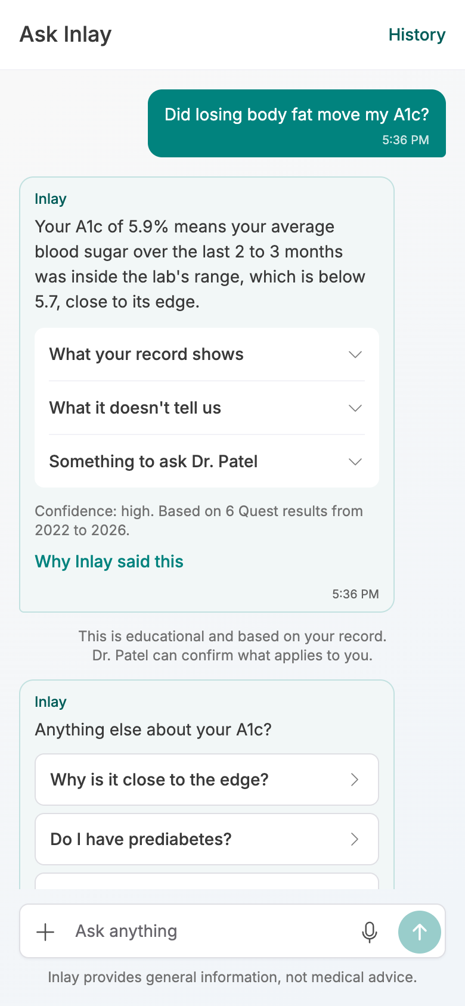
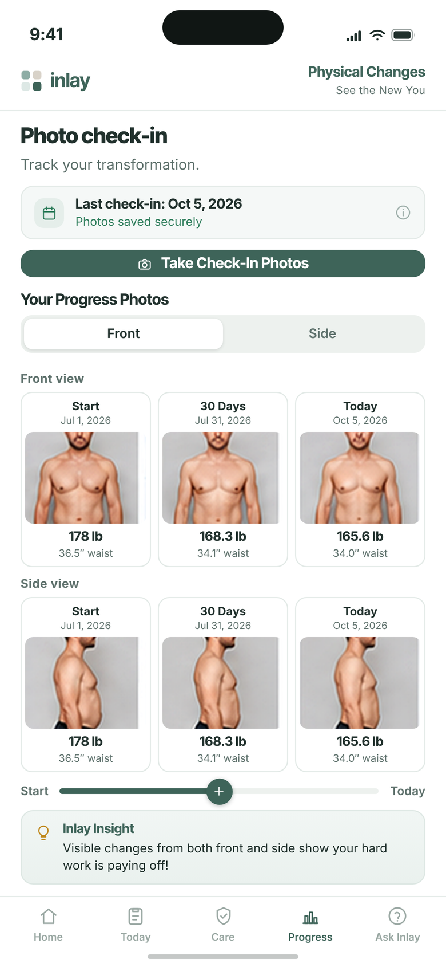
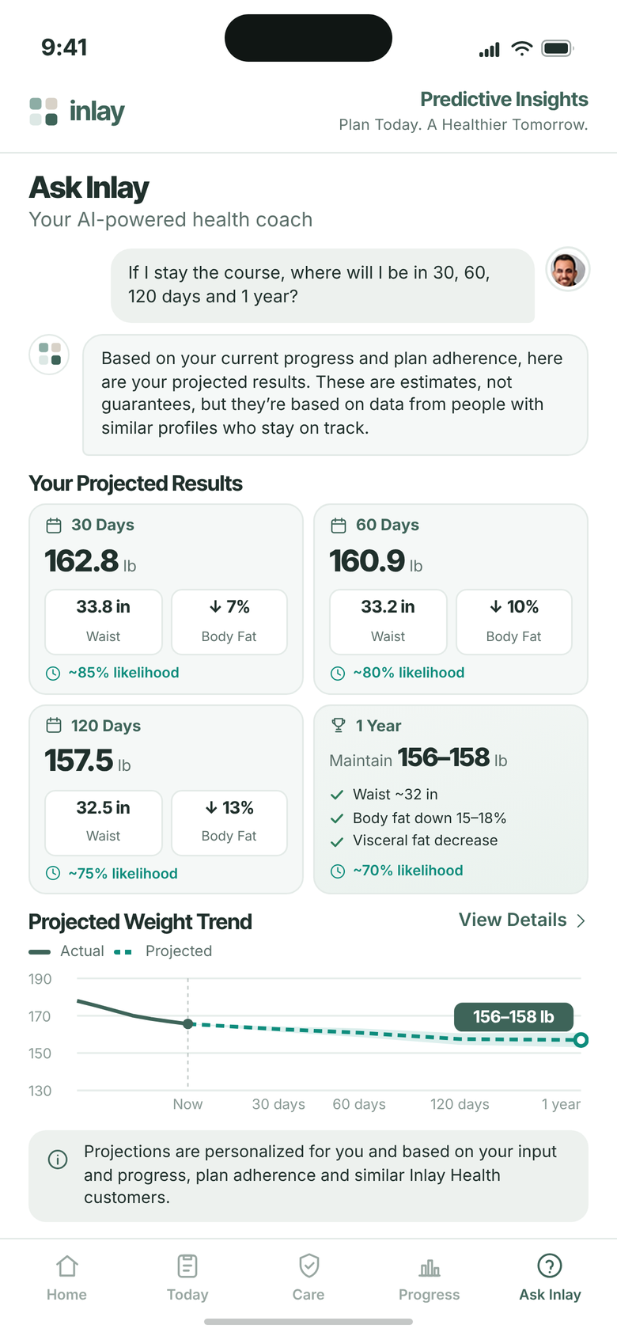
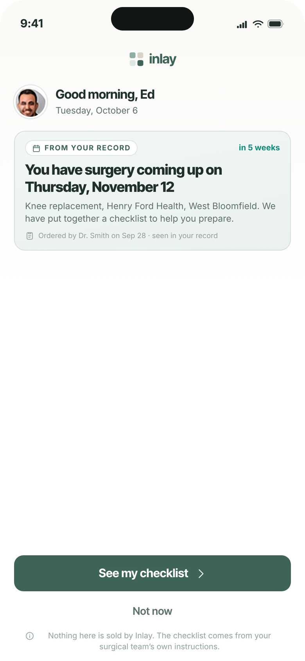
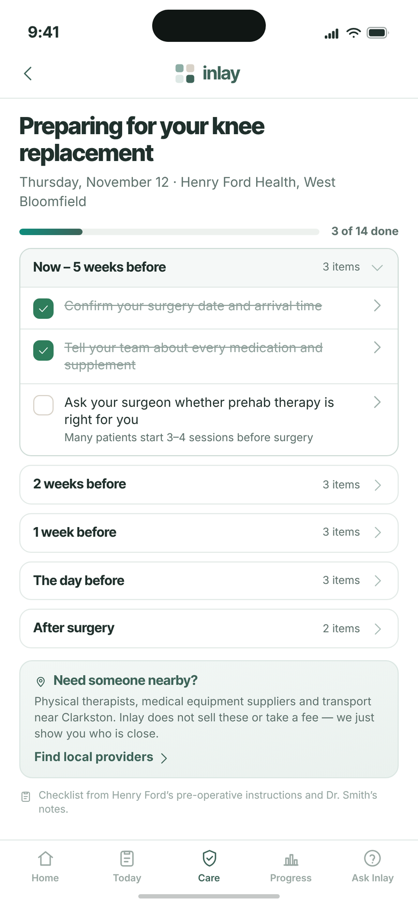
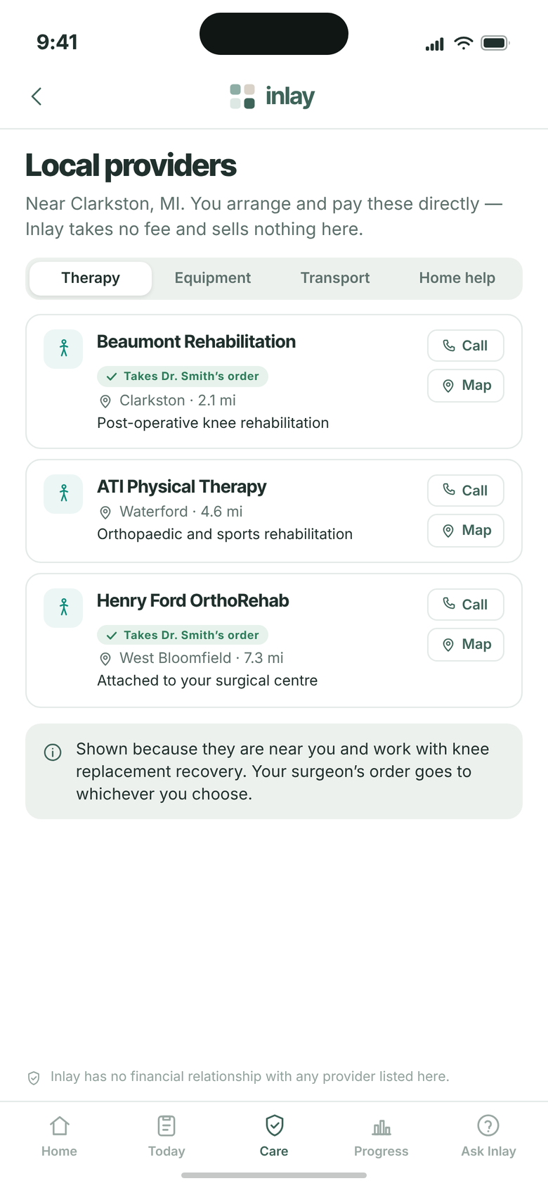
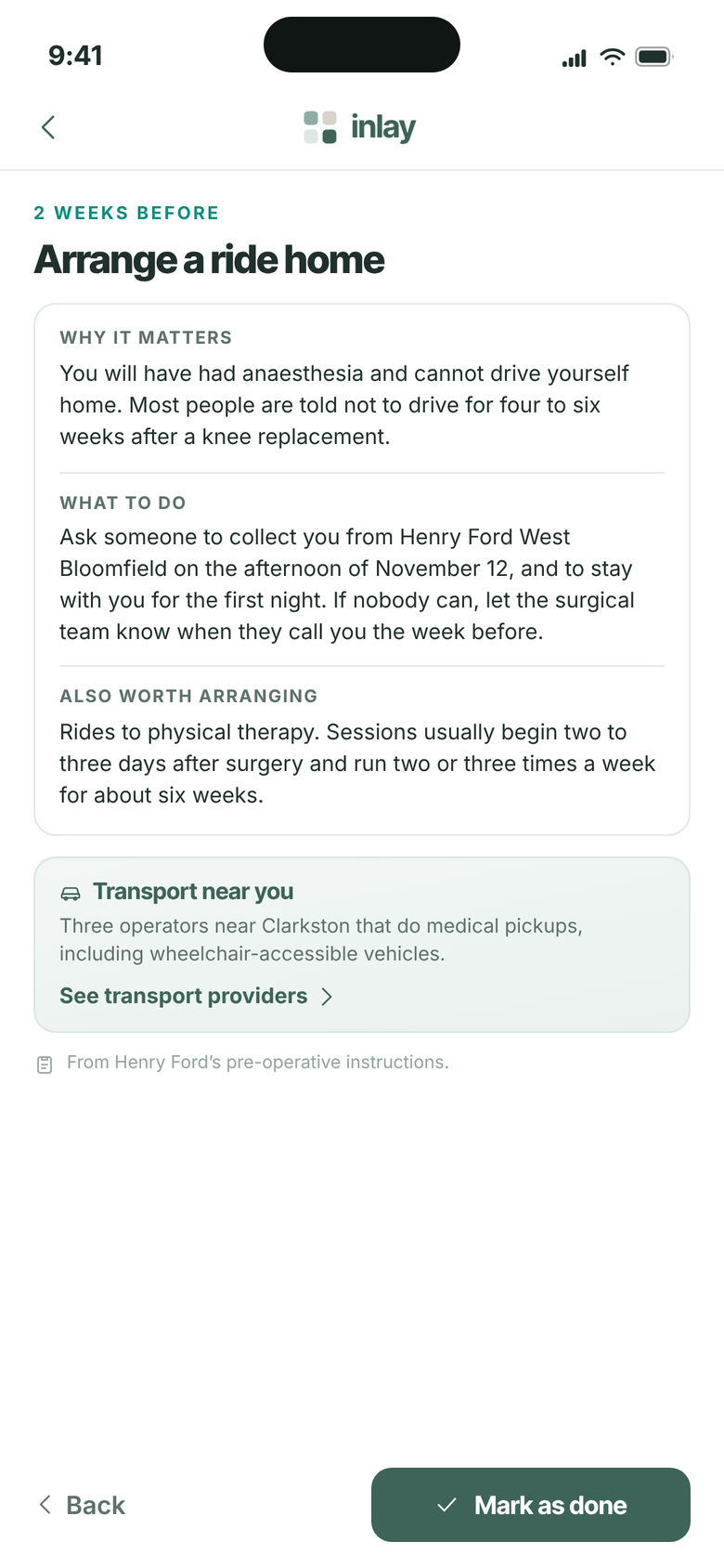
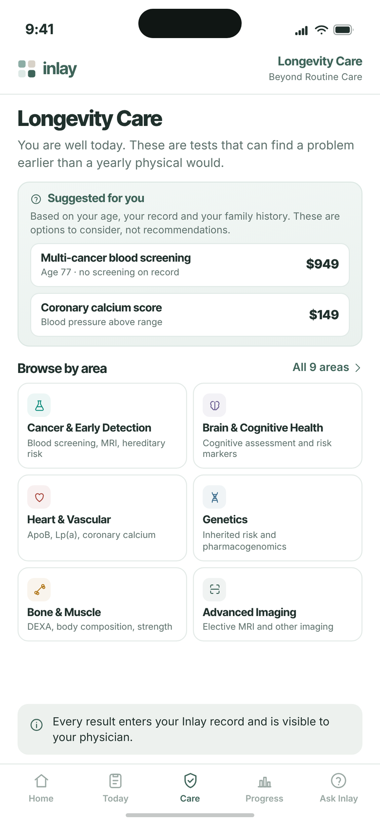
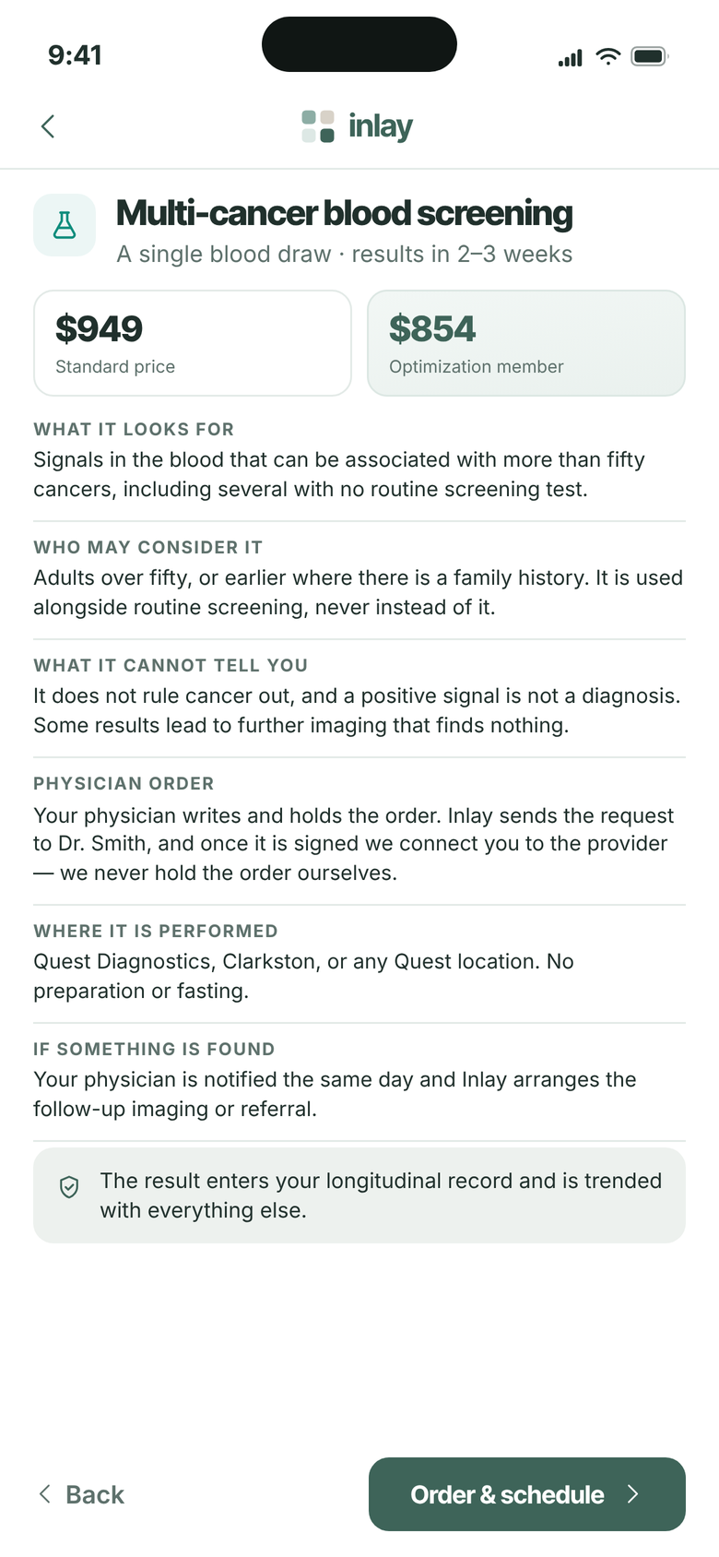
OPTIMIZATION PROGRAM · VERSION 16
The Patient Journey
48 screens, from activating the account to the member's daily plan.
01 Activate & Sign In
02 Consent & Connect
03 Onboarding
04 Dashboard
05 Optimization Plan
06 Daily Use
07 Inlay Care
48 screens · 7 stages · 20 new or changed after 19 Oct
Internal discussion draft · 21 October 2026 · updated after the 19 Oct call
Screens captured from the current local build

Slide 2

What changed since version 15
Setup now connects Epic or Oracle and asks for three symptoms, Home opens on biological age, the Plan tab replaces Upgrade, and the symptoms feed the plan picks.
New
6
Changed
13
Moved
1
Concept
8
Removed
6
6 Link Your Record System
8 Your Why
10 What Matters Most
12 Your Biological Age
21 Your Plan Would Work on Five Things
38 Plan
1 Activate Your Account
5 Connect Your Health Records
9 Building Your Record
11 Your Record Is Ready
13 First Look: App Tour
14 Home
20 Plan Tab: Welcome, Liv
22 What Your Baseline Needs
23 Complete Your Enrollment
36 Yesterday: How Did I Do?
37 Today: Personalized Plan
39 Progress
40 Ask Inlay: Your Results
7 Updates About Your Care
41 Photo Check-In
42 Ask Inlay: Predictive Insights
43 First Screen: Surgery Detected
44 Preparation Checklist
45 Local Providers
46 Checklist Item
47 Longevity Care
48 Longevity Care: Test Detail
v15 screen 1 Invitation email
v15 screens 8 to 10 The eight life questions
v15 screens 13 to 15 Record tour pages
v15 screens 16 and 17 Biological age pages
v15 screens 27 and 28 What would you like to improve?
v15 tab bar Connect and Upgrade tabs
INLAY HEALTH · OPTIMIZATION PATIENT JOURNEY
SUMMARY
2

Slide 3
STAGE 01
Activate & Sign In
1
2
3
Three screens from activation in the app to a signed in patient. The patient never invents a username or waits for a call.
Screens 1 to 3

Slide 4
1
STAGE 01 · ACTIVATE & SIGN IN
Changed
Activate Your Account
Email, birth date, one code
The patient starts in the app itself. The code is checked against the email and date of birth the clinic already holds, so a code on its own cannot open anyone's record.
Three fields and one button: Verify code
What changed
Patients activate in the app; the patient invitation email is removed (21 Oct)
No invitation email from the patient app any more; staff invite emails stay
Already set a password? Sign in sits under the button
INLAY HEALTH · OPTIMIZATION PATIENT JOURNEY
SCREEN 1 OF 48
4

Slide 5
2
STAGE 01 · ACTIVATE & SIGN IN
Create Your Password
The only thing the patient chooses
Once the code is accepted the patient sets a password, with the same rules as the web portals. There is no username to invent and no second factor to set up.
New password and confirmation, each with a show toggle
Set password goes straight to Sign in with the email filled in
Same rules as the clinic and admin portals
INLAY HEALTH · OPTIMIZATION PATIENT JOURNEY
SCREEN 2 OF 48
5

Slide 6
3
STAGE 01 · ACTIVATE & SIGN IN
Sign In
Straight back in
Straight after the password is created the email is already filled in, so the new password is all there is to type.
Returning patients land here too: email and password
Forgot password sits under the password field
Signing in opens setup where the patient left it
INLAY HEALTH · OPTIMIZATION PATIENT JOURNEY
SCREEN 3 OF 48
6

Slide 7
STAGE 02
Consent & Connect
4
5
6
7
8
The patient confirms who they are, gives one consent, links Epic or Oracle, agrees to care updates, and sees what the free account does.
Screens 4 to 8

Slide 8
4
STAGE 02 · CONSENT & CONNECT
Is This You?
Confirm, don't type
The details come from the clinic's record and are shown view only. They are what the record networks match the patient on, so they have to be the practice's own.
Olivia Bennett, goes by Liv, female, 45, from the clinic
Date of birth, mobile, email and home address, read only
Your clinic: Harborview Longevity Clinic shares the record with them
INLAY HEALTH · OPTIMIZATION PATIENT JOURNEY
SCREEN 4 OF 48
8

Slide 9
5
STAGE 02 · CONSENT & CONNECT
Changed
Connect Your Health Records
Consent comes before any data
Nothing medical is read until the patient agrees. Who sees the records and what is collected sit in two lines, then two boxes to tick.
Who sees them: you and Harborview Longevity Clinic
What changed
Now leads into connecting a record system; Updates about your care moved after it
What we collect: visits, labs and 7 more, with See all
One box for the HIPAA authorization, one for privacy, terms and lab request terms
INLAY HEALTH · OPTIMIZATION PATIENT JOURNEY
SCREEN 5 OF 48
9

Slide 10
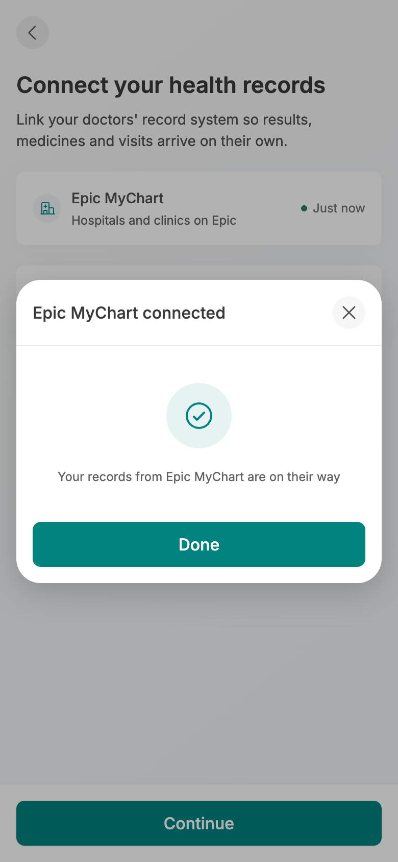
6
Before connecting
Connected
STAGE 02 · CONSENT & CONNECT
New
Link Your Record System
Epic or Oracle, one tap
Straight after consent the patient links the record system their doctors use. Continue stays off until one is connected, and connecting opens as a centred popup.
Two systems only: Epic MyChart and Oracle Health, no devices
Connecting shows a short sign in, then Epic MyChart connected
What changed
New step in setup (21 Oct): connect Epic or Oracle before going on
INLAY HEALTH · OPTIMIZATION PATIENT JOURNEY
SCREEN 6 OF 48
10

Slide 11
7
STAGE 02 · CONSENT & CONNECT
Moved
Updates About Your Care
How Inlay may reach them
The second consent page covers contact about care: texts, calls and email. Agreeing here signs the consent and moves on.
Three separate permissions, so a patient can take texts and decline calls
What changed
Now comes after Connect your health records
Texts cover new results and reminders, with the messaging terms linked
Agree and continue opens Your why
INLAY HEALTH · OPTIMIZATION PATIENT JOURNEY
SCREEN 7 OF 48
11

Slide 12
8
STAGE 02 · CONSENT & CONNECT
New
Your Why
What the free account does
Before anything else is asked, five lines on what the account already does for the patient. It is free, and it stays free.
A complete longitudinal record; medication and appointment management
What changed
New: states the value of the free record before any question (21 Oct)
Order status, a physical and emotional review, and Ask Inlay: five questions a week free
A blue note: none of this asks you to buy anything
INLAY HEALTH · OPTIMIZATION PATIENT JOURNEY
SCREEN 8 OF 48
12

Slide 13
STAGE 03
Onboarding
9
10
11
The record builds while the patient names the three symptoms that bother them most and rates each one, then the finished record opens Home.
Screens 9 to 11

Slide 14
9
STAGE 03 · ONBOARDING
Changed
Building Your Record
The record builds while they go on
The record pull starts after consent, and the patient does not have to wait for it. A running count shows it arriving, then Continue while it builds.
27 records so far, then 113, from Harborview Longevity Clinic
What changed
Now runs before the questions; the patient continues while it builds
Other providers answer over minutes, sometimes up to a day
New records land on their own and show up in To do
INLAY HEALTH · OPTIMIZATION PATIENT JOURNEY
SCREEN 9 OF 48
14

Slide 15
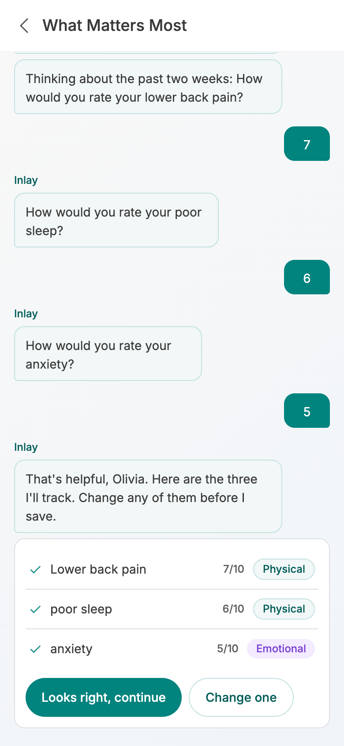
10
Rating each symptom
Read back to confirm
STAGE 03 · ONBOARDING
New
What Matters Most
Three symptoms, in their own words
The eight life questions are gone. One conversation asks for the three physical or emotional symptoms that bother the patient most, typed or spoken.
"What are the three symptoms that bother you most right now?"
Each one is rated 1 to 10 in one tap, thinking about the past two weeks
What changed
Replaces the 8 life questions and Pick three (19 Oct call)
INLAY HEALTH · OPTIMIZATION PATIENT JOURNEY
SCREEN 10 OF 48
15

Slide 16
11
STAGE 03 · ONBOARDING
Changed
Your Record Is Ready
168 records, then the dashboard
The finished record is summarised by type. The button now finishes setup and opens Home with the biological age sheet already up.
168 records from 3 providers: lab results 86, vitals 32, visits 14
What changed
The trends, biological age and what is driving it pages left setup; Home shows them
Medications 6, conditions 5, allergies 2, documents 11
See what my record does opens Home, not a separate tour
INLAY HEALTH · OPTIMIZATION PATIENT JOURNEY
SCREEN 11 OF 48
16

Slide 17
STAGE 04
Dashboard
12
13
14
15
16
The free record: biological age first, then trends, what is coming up, every result, what is open, and an assistant that knows the record.
17
18
19
Screens 12 to 19

Slide 18
12
STAGE 04 · DASHBOARD
New
Your Biological Age
53, against a calendar age of 45
The first thing Home shows is the biological age, as a sheet over the dashboard, with the four results that drive it.
53, eight years older: your body tests older than your 45 years
What changed
Biological age and what drives it now open on Home as one sheet
What is driving it: BMI 32.4, LDL 162, triglycerides 188, blood pressure 134/86
See optimization plan opens the plan match
INLAY HEALTH · OPTIMIZATION PATIENT JOURNEY
SCREEN 12 OF 48
18

Slide 19

13
Step 1: the tabs
Step 2: Ask Inlay
STAGE 04 · DASHBOARD
Changed
First Look: App Tour
Three steps, shown once
After the sheet closes, a three step tour runs over the live dashboard and can be skipped.
Find your way around: the tab bar
Ask your health assistant: the ring fills as the week's AI credit is used
What changed
Tour copy still names Connect and Upgrade tabs; to fix
INLAY HEALTH · OPTIMIZATION PATIENT JOURNEY
SCREEN 13 OF 48
19

Slide 20
14
STAGE 04 · DASHBOARD
Changed
Home
Biological age first, then trends
The free home now opens with the Biological Age card, then how results are moving, then the upgrade banner.
Biological Age card: 53, 8 years older, opens the sheet
What changed
Biological Age card added to the free home (21 Oct)
Your trends: LDL 162, triglycerides 188, blood pressure 134/86 above target; peak flow in range
A healthier you is possible: the upgrade banner after the trends
INLAY HEALTH · OPTIMIZATION PATIENT JOURNEY
SCREEN 14 OF 48
20

Slide 21

15
Upcoming and new
To do and Ask Inlay
STAGE 04 · DASHBOARD
Home: Further Down
Upcoming, new, and medicines
Below the trends, Home shows what is booked, what has just arrived in the record, the medicines on file and the open to dos.
Cardiology follow up Wed 21 with Dr. Lee at Pacific Heart
New in your record: urgent care at Scripps and a cardiology visit, outside your clinic
Atorvastatin 20 mg marked Records differ; book a mammogram, overdue
INLAY HEALTH · OPTIMIZATION PATIENT JOURNEY
SCREEN 15 OF 48
21

Slide 22
16
STAGE 04 · DASHBOARD
Record
Every result, with its trend
The Record tab holds the whole record, with results grouped by body system.
Category pills on top, body system chips under them
LDL 162, triglycerides 188, BP 134/86, BMI 32.4 above target; vitamin D 21 below
Add to your record for anything the networks missed
INLAY HEALTH · OPTIMIZATION PATIENT JOURNEY
SCREEN 16 OF 48
22

Slide 23
17
STAGE 04 · DASHBOARD
Result Detail
LDL 162, and how it got there
Opening a result shows the latest value against its range, every past reading on one chart, and where each one came from.
Out of range and trending up: 162 mg/dL, Aug 14 2026, Quest Diagnostics
Up from 128 in Apr 2022, across 4 results
Ask Inlay at the foot of the page
INLAY HEALTH · OPTIMIZATION PATIENT JOURNEY
SCREEN 17 OF 48
23

Slide 24
18
STAGE 04 · DASHBOARD
To Do
What is open, in order
Care gaps, bookings and checks in one list, split into overdue, upcoming and completed.
2 overdue: book a mammogram, due Apr 4, and a follow up visit
Check 3 medicines; an echocardiogram and a repeat A1c and lipid panel
Dec 8 record review by Dr. Patel
INLAY HEALTH · OPTIMIZATION PATIENT JOURNEY
SCREEN 18 OF 48
24

Slide 25
19
STAGE 04 · DASHBOARD
Ask Inlay
An assistant that knows the record
The assistant opens on four plain starting points. Credit is shown as a share of the week used, never as a count of questions.
Explain a result, prepare for a visit, a medicines question, something is bothering me
0% of this week's AI credit used, on the strip above the composer
An upgrade banner offers more credit and a personalized plan
INLAY HEALTH · OPTIMIZATION PATIENT JOURNEY
SCREEN 19 OF 48
25

Slide 26
STAGE 05
Optimization Plan
20
21
22
23
24
25
From the Plan tab to an accepted plan: the 3 of 81 match plus what the patient's symptoms add, baseline tests, enrollment and HSA or FSA payment, test booking, flourishing, then the plan itself.
26
27
28
29
30
31
Screens 20 to 35
32
33
34
35

Slide 27

20
The plan match
All 81 plans
STAGE 05 · OPTIMIZATION PLAN
Changed
Plan Tab: Welcome, Liv
Three of 81 plans
The Plan tab takes the place of the Upgrade tab, and the biological age sheet's See optimization plan opens it. The record is compared with all 81 plans.
81 plans on file, 3 your record supports: lipid and cardiovascular, triglyceride and insulin, metabolic and weight
Each plan names the result behind it: LDL 162, up 34 since Apr 2022
What changed
Tabs are now Home, To do, Record, Plan, Care; the Upgrade and Connect tabs are gone
INLAY HEALTH · OPTIMIZATION PATIENT JOURNEY
SCREEN 20 OF 48
27

Slide 28
21
STAGE 05 · OPTIMIZATION PLAN
New
Your Plan Would Work on Five Things
The record, then their own words
Step 1 of 4. The plans the record supports, then the ones the patient's own symptoms add, each saying where it came from.
From your record: the 3 biomarker matches
What changed
Replaces the goals list: the symptoms from setup now feed the plan picks (19 Oct)
From what you told us: sleep restoration and SMART stress and resiliency
Each added plan quotes the patient: "You said you wake at three"
INLAY HEALTH · OPTIMIZATION PATIENT JOURNEY
SCREEN 21 OF 48
28

Slide 29

22
The tests
Why a DEXA
STAGE 05 · OPTIMIZATION PLAN
Changed
What Your Baseline Needs
Four tests, each with a Why
Step 2 of 4. The tests that give the plan its starting point, each priced, each switchable, each with an info sheet.
DEXA $149, RMR $129, comprehensive blood panel $189
Home sleep study $299, added for the sleep plan
What changed
Tests follow the five plans; the sleep study joins for sleep restoration
INLAY HEALTH · OPTIMIZATION PATIENT JOURNEY
SCREEN 22 OF 48
29

Slide 30

23
Yearly billing
What's included
STAGE 05 · OPTIMIZATION PLAN
Changed
Complete Your Enrollment
Yearly or monthly, step 3 of 4
The membership, its billing and the tests, all priced before payment.
Yearly $1,080 (save 10%), or $100 a month
What's included: multi goal plan, testing, nutrition and exercise, AI insights, physician approval, tracking
What changed
Yearly shown first; the total carries the sleep study
INLAY HEALTH · OPTIMIZATION PATIENT JOURNEY
SCREEN 23 OF 48
30

Slide 31

24
HSA or FSA picked
Cost breakdown
STAGE 05 · OPTIMIZATION PLAN
Payment Method
HSA or FSA, like any card
Step 4 of 4. Credit card, HSA or FSA, Apple Pay or Google Pay, with the full breakdown one tap away.
HSA or FSA card number replaces the card label when it is picked
Breakdown: tests $467 less the 10% member discount, sleep study $299, membership $1,080
Complete enrollment stays off until the agreement is ticked
INLAY HEALTH · OPTIMIZATION PATIENT JOURNEY
SCREEN 24 OF 48
31

Slide 32
25
STAGE 05 · OPTIMIZATION PLAN
Payment Complete
Paid, with a receipt
Once the payment goes through, a popup confirms it before the enrolled page.
$1,799.30 paid to Inlay Health with the HSA or FSA card ending 4242
Oct 21, 2026, receipt INL-85172163
Download receipt or Continue
INLAY HEALTH · OPTIMIZATION PATIENT JOURNEY
SCREEN 25 OF 48
32

Slide 33
26
STAGE 05 · OPTIMIZATION PLAN
You're Enrolled
What happens next, in order
The membership has started. The screen lists each next step with the physician named.
Optimization membership, $1,080 a year
Enrolled, schedule your tests, Dr. Patel reviews your plan, your plan is ready
Schedule my tests, or Schedule later
INLAY HEALTH · OPTIMIZATION PATIENT JOURNEY
SCREEN 26 OF 48
33

Slide 34

27
To book
All three booked
STAGE 05 · OPTIMIZATION PLAN
Schedule Tests
A day and a time for each test
Each paid test with its place, a date and a time. Confirm schedule books them all at once.
Blood panel at Quest Diagnostics, DEXA at Coastal Imaging, RMR at Harborview
Weekdays from Oct 22 open; morning slots for the blood draw
Confirm schedule books all three
INLAY HEALTH · OPTIMIZATION PATIENT JOURNEY
SCREEN 27 OF 48
34

Slide 35
28
STAGE 05 · OPTIMIZATION PLAN
Your Tests Are Scheduled
Booked, then personalize
Every test with its day, time and place, and a reminder before each one.
We've saved your 3 tests and will remind you before each one
Any test can be moved from To do
Personalize my care, or I'll do this later
INLAY HEALTH · OPTIMIZATION PATIENT JOURNEY
SCREEN 28 OF 48
35

Slide 36
29
STAGE 05 · OPTIMIZATION PLAN
Tell Us About You
From the record, then confirmed
The profile as the record has it, in three blocks. The patient confirms it, and Confirm opens Are you flourishing?
Basic information: 45, 5 ft 8 in, 213 lb, BMI 32.4, waist 41 in
Lifestyle: low carb, 3 meals, exercise 5 to 6 days, 6 h sleep
Medical, from your record: prediabetes, hyperlipidemia, atorvastatin, penicillin allergy
INLAY HEALTH · OPTIMIZATION PATIENT JOURNEY
SCREEN 29 OF 48
36

Slide 37

30
Before the video
Video playing
STAGE 05 · OPTIMIZATION PLAN
Are You Flourishing?
A short video from Dr. Patel
Why first, then what: a 30 second video on why flourishing matters, then how the questions work.
Your health is more than your numbers: captions play over the video
Watch the video, answer 39 questions, see your result
The result is shared with Dr. Patel
INLAY HEALTH · OPTIMIZATION PATIENT JOURNEY
SCREEN 30 OF 48
37

Slide 38
31
STAGE 05 · OPTIMIZATION PLAN
Flourishing Question
One question, ten buttons
One question a page, the part of life as a coloured chip, 1 of 39 and a thin bar.
How would you rate your overall physical health?
A 1 to 10 scale: 1 not at all to 10 completely
The last question turns the button into See my result
INLAY HEALTH · OPTIMIZATION PATIENT JOURNEY
SCREEN 31 OF 48
38

Slide 39
32
STAGE 05 · OPTIMIZATION PLAN
Your Flourishing Result
A score per part of life
The flourishing index out of 10, the strongest and weakest parts of life, then each part as its own bar.
Flourishing index 6.0 out of 10
Your strength: relationships 7.8; room to grow: finances 4.0
Shared with Dr. Patel to shape your plan
INLAY HEALTH · OPTIMIZATION PATIENT JOURNEY
SCREEN 32 OF 48
39

Slide 40
33
STAGE 05 · OPTIMIZATION PLAN
Your Plan Is Ready
Approved, and attributed
Shown once, when Dr. Patel's version 1 is ready.
Built from your results, reviewed by Dr. Patel
Read your plan: accept it or request a change
View my plan
INLAY HEALTH · OPTIMIZATION PATIENT JOURNEY
SCREEN 33 OF 48
40

Slide 41

34
The plan
Further down
STAGE 05 · OPTIMIZATION PLAN
Read Your Plan
Nothing starts until they accept
The full plan, with two actions pinned over the tab bar: Request a change and Accept plan.
Version 1, approved by Dr. Patel: 3 plans, 13 items
Blood sugar, weight and heart, each with its Why
Baseline tests, 3 approved
INLAY HEALTH · OPTIMIZATION PATIENT JOURNEY
SCREEN 34 OF 48
41

Slide 42

35
Request a change
Accepted, now active
STAGE 05 · OPTIMIZATION PLAN
Accept or Request a Change
Two ways forward
A change request sends the patient's own words to Dr. Patel. Accepting starts the plan at once.
Request a change: what would you like changed? then Send to Dr. Patel
Accept: the plan goes live with weight, today's workout and the next test
81% of the way to 175 lb
INLAY HEALTH · OPTIMIZATION PATIENT JOURNEY
SCREEN 35 OF 48
42

Slide 43
STAGE 06
Daily Use
36
37
38
39
40
What a member sees every day: yesterday's score, today's plan, the live plan, progress with its forecast, and answers from the record. Two screens are still concepts.
41
42
Screens 36 to 42

Slide 44

36
Score and energy
Each goal
STAGE 06 · DAILY USE
Changed
Yesterday: How Did I Do?
The first screen every morning
One score, one insight and the day's goals: the whole of yesterday in one place.
96% daily score, 3 of 5 goals met, 7 day average 94%
Energy balance: 1,480 in, 1,810 out, a 330 deficit against a 300 goal
What changed
Now captured from the build; goals are protein, calcium, exercise and water
INLAY HEALTH · OPTIMIZATION PATIENT JOURNEY
SCREEN 36 OF 48
44

Slide 45

37
Today's to do
Workout and meals
STAGE 06 · DAILY USE
Changed
Today: Personalized Plan
The day's to do, then the food
Today lists what is left to do, the day's goals, the workout and four ways to eat the plan.
0 of 4 done: log a meal, Strength A, a walk after dinner, check blood pressure
Goals: 1,700 kcal, 110 g protein, 28 g fiber, 40 min exercise
What changed
Now captured from the build: to do list and workout added
INLAY HEALTH · OPTIMIZATION PATIENT JOURNEY
SCREEN 37 OF 48
45

Slide 46
38
STAGE 06 · DAILY USE
New
Plan
Version 2, approved by Dr. Patel
The live plan: the membership, where the patient stands against the goal, and the daily targets.
Weight 177.6 lb against a goal of 175: 81% of the way
What changed
New slide: the member Plan tab
Focus: blood sugar (A1c below 5.7), weight, heart (LDL below 100)
Daily targets: up to 1,700 kcal, 110 g protein, 28 g fiber, 25 g added sugar at most
INLAY HEALTH · OPTIMIZATION PATIENT JOURNEY
SCREEN 38 OF 48
46

Slide 47

39
Weight and forecast
Body composition
STAGE 06 · DAILY USE
Changed
Progress
Week 25
The screen the patient shows other people, and the one that renews the subscription.
11.4 lb down since May 3; 11 lb of body fat lost on DEXA
Forecast: may reach 175 lb by early December, an estimate, not a guarantee
What changed
The forecast now lives on Progress, not in Ask Inlay
INLAY HEALTH · OPTIMIZATION PATIENT JOURNEY
SCREEN 39 OF 48
47

Slide 48
40
STAGE 06 · DAILY USE
Changed
Ask Inlay: Your Results
An answer with its sources
For a member the assistant answers from the record, says what it cannot tell, and suggests what to ask the doctor.
"Did losing body fat move my A1c?": A1c 5.9%
What changed
Replaces the predictive insights screen, which is not built
What your record shows, what it doesn't tell us, something to ask Dr. Patel
Confidence: high, based on 6 Quest results from 2022 to 2026
INLAY HEALTH · OPTIMIZATION PATIENT JOURNEY
SCREEN 40 OF 48
48

Slide 49
41
STAGE 06 · DAILY USE
Concept
Photo Check-In
Evidence they can see
Front and side, three dates, with weight and waist under each frame.
Jul 1, 178 lb · Jul 31, 168.3 lb · Oct 5, 165.6 lb
What changed
Not in the build: the app logs meal photos, not body photos
Photographs stored securely; the comparison slider is the moment patients share
Visible change is what holds a subscription together when the scale stalls
INLAY HEALTH · OPTIMIZATION PATIENT JOURNEY
SCREEN 41 OF 48
49

Slide 50
42
STAGE 06 · DAILY USE
Concept
Ask Inlay: Predictive Insights
Where this goes if they stay
The retention screen. It answers the question every patient asks at month three.
30 days 162.8 lb · 60 days 160.9 lb · 120 days 157.5 lb · 1 year 156 to 158 lb
What changed
Not in the build: only the weight forecast on Progress exists
Every projection carries a likelihood: 85%, 80%, 75% and 70%
Framed as estimates drawn from similar patients, never as a promise
INLAY HEALTH · OPTIMIZATION PATIENT JOURNEY
SCREEN 42 OF 48
50

Slide 51
STAGE 07
Inlay Care
43
44
45
46
47
Concepts carried from version 15. None of these screens is in the build yet: surgery support from the record, and Longevity Care, the paid elective catalogue.
48
Screens 43 to 48

Slide 52
43
STAGE 07 · INLAY CARE
Concept
First Screen: Surgery Detected
Proof that we know them
When Inlay sees the surgery in the record, this takes the screen before Home. It says one thing, and that one thing is the whole argument for the free record.
"You have surgery coming up on Thursday, November 12": named, dated, five weeks ahead
What changed
Not in the build yet: carried from version 15 as a concept
Ordered by Dr. Smith on Sep 28, and the screen says so
Nothing is sold here: the checklist comes from the surgical team
INLAY HEALTH · OPTIMIZATION PATIENT JOURNEY
SCREEN 43 OF 48
52

Slide 53
44
STAGE 07 · INLAY CARE
Concept
Preparation Checklist
Fourteen things, in the right order
Grouped by when each one matters, so the patient sees the three things to do now instead of a wall of instructions five weeks early.
3 of 14 done, with the current group open and the rest collapsed
What changed
Not in the build yet: carried from version 15 as a concept
The content is the hospital's own pre-operative instructions and Dr. Smith's notes
One box at the foot for local providers, worded as help
INLAY HEALTH · OPTIMIZATION PATIENT JOURNEY
SCREEN 44 OF 48
53

Slide 54
45
STAGE 07 · INLAY CARE
Concept
Local Providers
Who is nearby, and nothing else
Therapy, equipment, transport and home help nearby. The patient arranges and pays directly; Inlay takes no fee.
Two of the three clinics already accept Dr. Smith's order
What changed
Not in the build yet: carried from version 15 as a concept
Call and Map. No price, no booking, no checkout
Inlay has no financial relationship with any provider listed
INLAY HEALTH · OPTIMIZATION PATIENT JOURNEY
SCREEN 45 OF 48
54

Slide 55
46
STAGE 07 · INLAY CARE
Concept
Checklist Item
Why, not just what
Opening an item gives the reason behind it, which turns a list of instructions into something a patient follows.
Why it matters, what to do, and what else to arrange
What changed
Not in the build yet: carried from version 15 as a concept
Dated and specific: collected on the afternoon of November 12
The transport box appears here too, when it is needed
INLAY HEALTH · OPTIMIZATION PATIENT JOURNEY
SCREEN 46 OF 48
55

Slide 56
47
STAGE 07 · INLAY CARE
Concept
Longevity Care
For the patient who comes looking
The elective side, and the one part of Inlay Care that is still sold. It is for the well patient who wants to find something early.
"You are well today" is the opening line
What changed
Not in the build yet: carried from version 15 as a concept
Suggested for you sits above the catalogue, from age, record and family history
Worded as options to consider, never as recommendations
INLAY HEALTH · OPTIMIZATION PATIENT JOURNEY
SCREEN 47 OF 48
56

Slide 57
48
STAGE 07 · INLAY CARE
Concept
Longevity Care: Test Detail
What it cannot tell you
Every elective test carries the same six disclosures, the limits included.
$949 standard, $854 for members, with the request routed to the physician
What changed
Not in the build yet: carried from version 15 as a concept
The physician writes and holds the order
"A positive signal is not a diagnosis" sits on the page, not in the terms
INLAY HEALTH · OPTIMIZATION PATIENT JOURNEY
SCREEN 48 OF 48
57

Slide 58
Taken out of the journey
Per the 19 Oct call and the 21 Oct build, these screens left the journey.
Removed
Removed
Removed
Invitation email
The eight life questions
Record tour pages
Was v15 screen 1
Was v15 screens 8 to 10
Was v15 screens 13 to 15
Patients now activate in the app; staff invite emails stay (21 Oct)
About your life, life question and pick three: replaced by three symptoms, each rated (19 Oct call)
Upcoming appointments, new medication and trending the wrong way: Home and To do show them
Removed
Removed
Removed
Biological age pages
What would you like to improve?
Connect and Upgrade tabs
Was v15 screens 16 and 17
Was v15 screens 27 and 28
Was v15 tab bar
Your biological age and what is driving it are now one sheet over Home, plus a Home card
The goals list and we updated your plans: the symptoms from setup now add the plans (19 Oct call)
Tabs are now Home, To do, Record, Plan, Care; connecting happens in setup
INLAY HEALTH · OPTIMIZATION PATIENT JOURNEY
REMOVED
58

Slide 59
STILL OPEN
Decisions these screens wait on
Records access window
SMART program
Open ended access until the patient cancels, in place of 15 days to 3 months: Ed to confirm with legal counsel.
SMART stress and resiliency as the base plan for everyone: licensing meeting 29 Oct.
HSA eligibility
Flourishing questions and licence
HOL to confirm with an ERISA attorney before the HSA or FSA option and receipt ship.
39 questions under Dr. Blanchard's review; Harvard licence and benchmark data with HOL.
Rejecting every plan
Biological age model
What happens when a patient declines all plans: a refund was suggested, nothing decided.
The age shown is a labelled sample until the model and its inputs are approved.

Slide 60
IN THE BUILD
Gaps found while capturing
Tour names old tabs
Change request not shown
Step 1 still says Connect and Upgrade; the tabs are Plan and Care.
The returned version still reads Version 1 and keeps 6 workout days.
Plan read differs from the picks
Apple Health while building
Five plans are picked, but the plan to read lists blood sugar, weight and heart.
Building your record lists Apple Health, although devices were dropped on 16 Oct.
Sleep study not scheduled
Care tab nearly empty
The $299 home sleep study is paid but missing from Schedule tests and the plan's baseline.
Care opens Membership with one card and no tab bar.
Weight disagrees
Concept screens
The profile says 213 lb; the plan says 177.6 lb, 81% of the way to 175.
Photo check-in, predictive insights and all of Inlay Care are not built yet.

